Slide 1


Integrating Jenkins with your GitHub Pull Request Workflow

Slide 2
Topics for today
Continuous integration
Jenkins
GitHub Pull Requests
Integrating the two services
Demo!

Slide 3
What is Continuous integration?
“Continuous integration (CI) is the practice of merging all developer working copies to a shared mainline several times a day” - Wikipedia
CI is the practice of merging all developer working copies to a testing machine, as soon as changes have been pushed, running tests and immediately reporting on the results
Code that did not pass tests gets rejected early and never gets integrated into the codebase - No bad code allowed in policy

Slide 4
Jenkins
Standalone automation server, most often used as a solution for CI
Unlike other CI solutions (Travis CI, CircleCI, Semaphore, etc.), Jenkins is hosted on your server (for better or worse), you have total control to run anything
Engine for running arbitrary scripts (tests)
Collects latest code from popular version control systems
Generates reports
Integrates with GitHub Status API

Slide 5
GitHub
Platform for hosting Git repositories
Supports Pull Request Workflows
Changes to the codebase must be reviewed before being accepted into the codebase
Without a CI server, the review process is manual labor (an engineer has to merge the code, review it, run tests, check for bugs)
With a CI server, most of it can be automated!

Slide 6
Pull Request Workflow
Image source: https://docs.rhodecode.com/RhodeCode-Enterprise/collaboration/pr-flow.html

Slide 7
Demo time!
But with screenshots :(

Slide 8
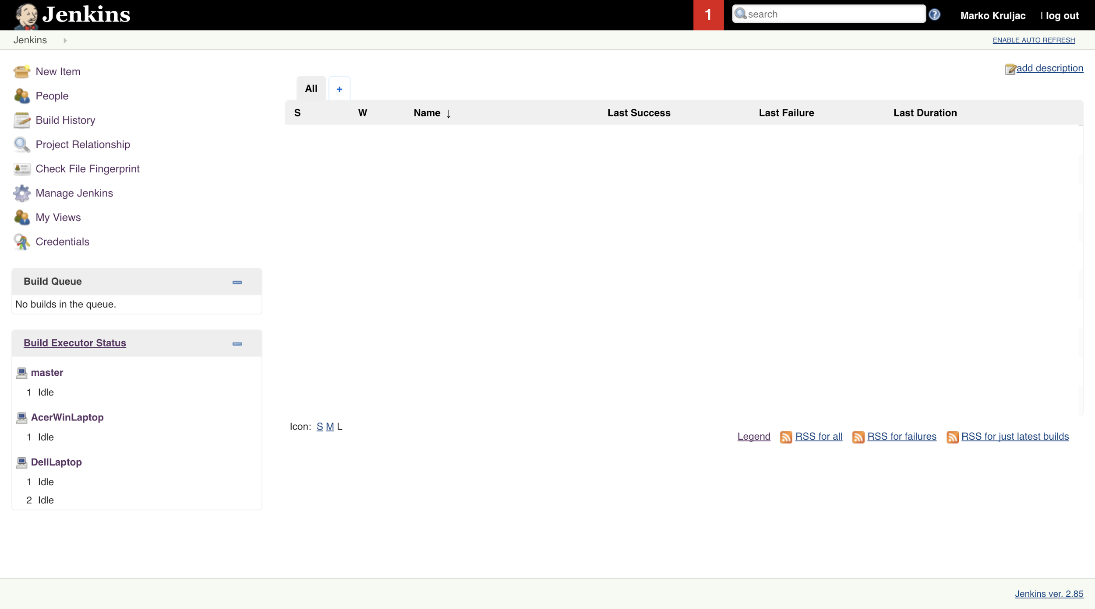

Slide 9
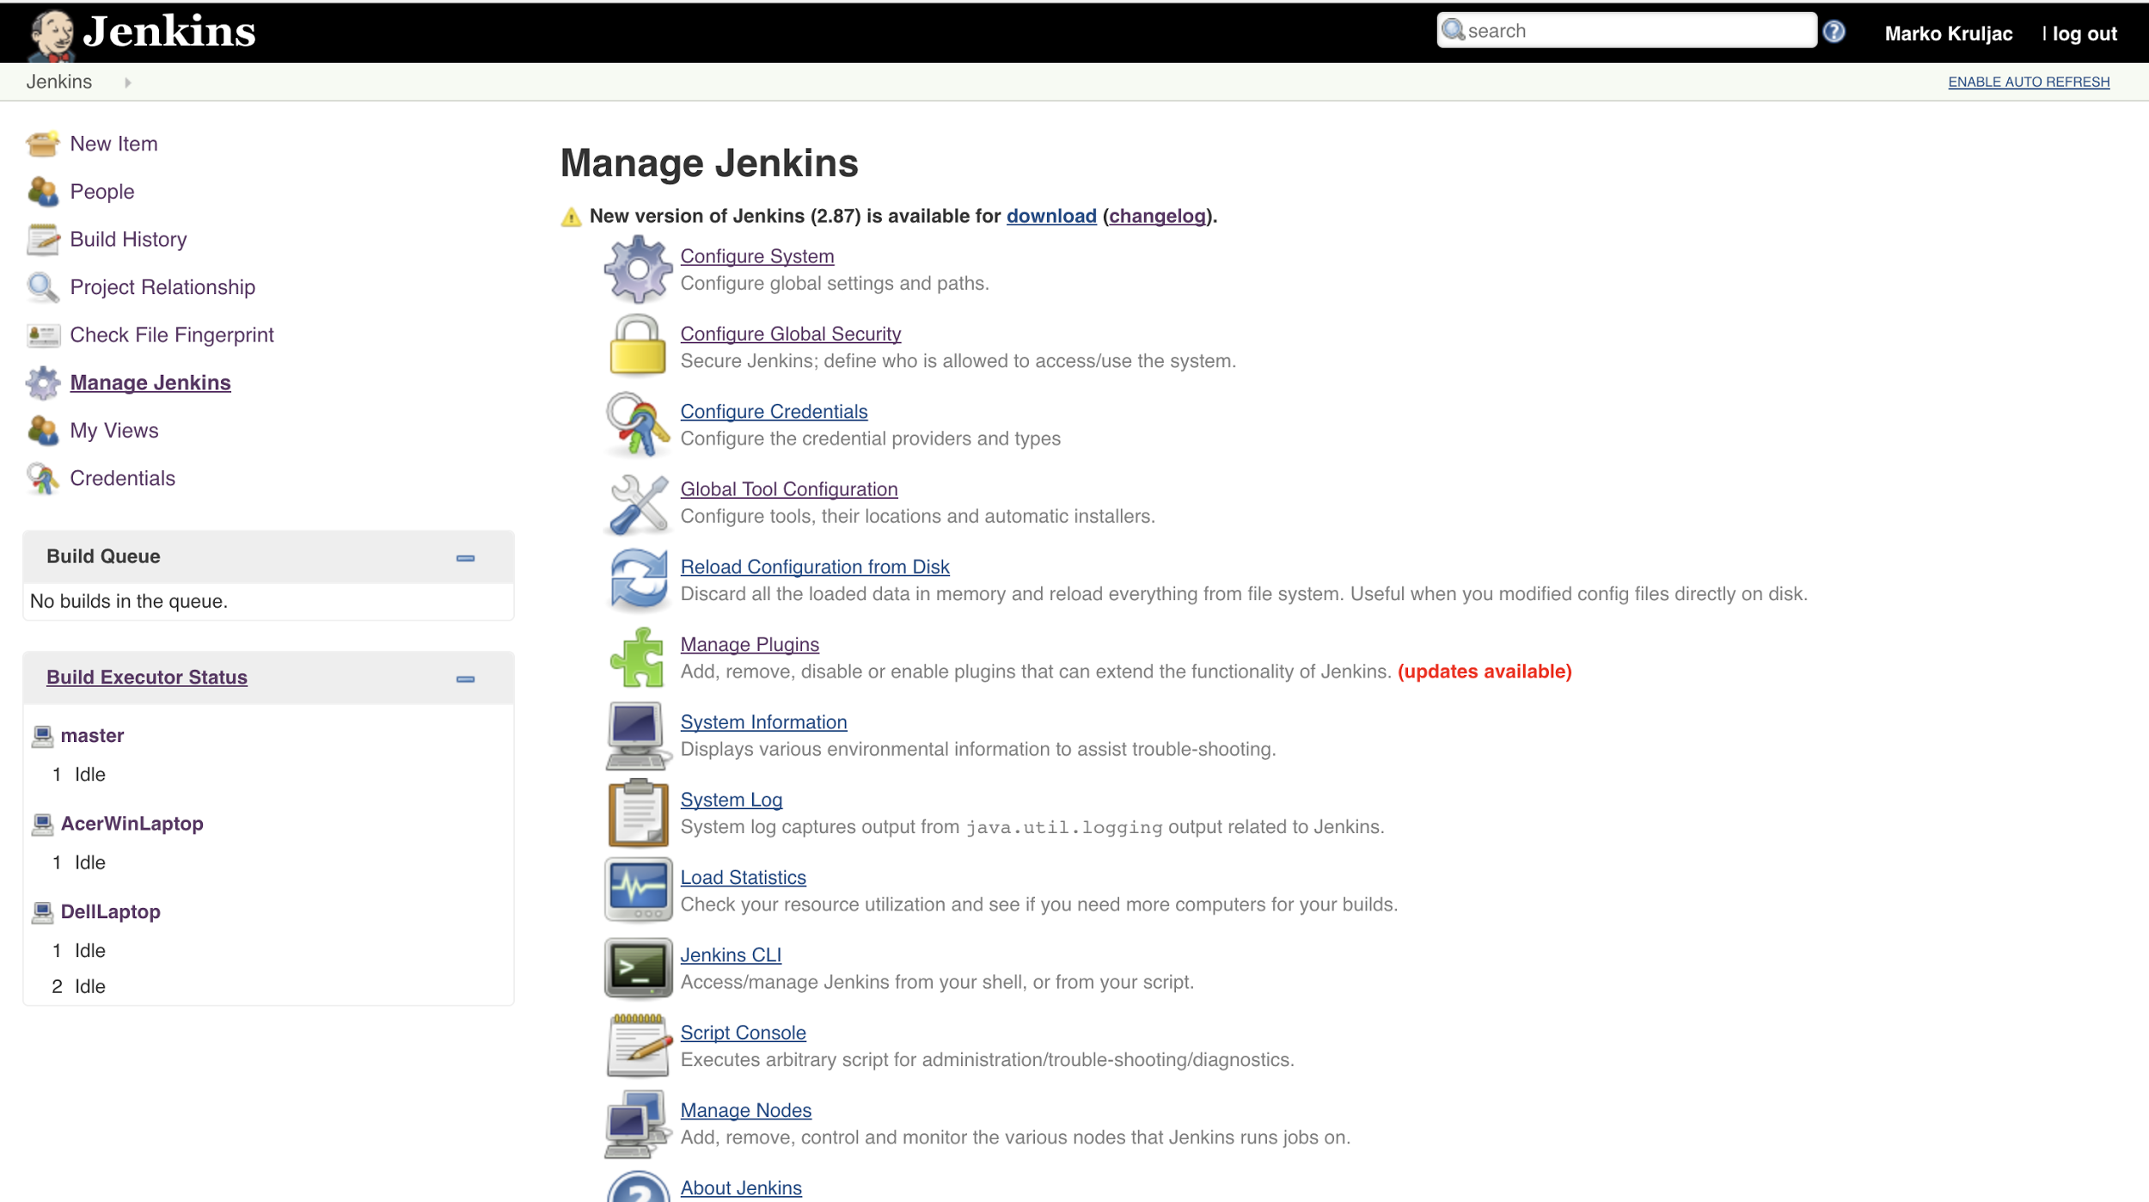

Slide 10
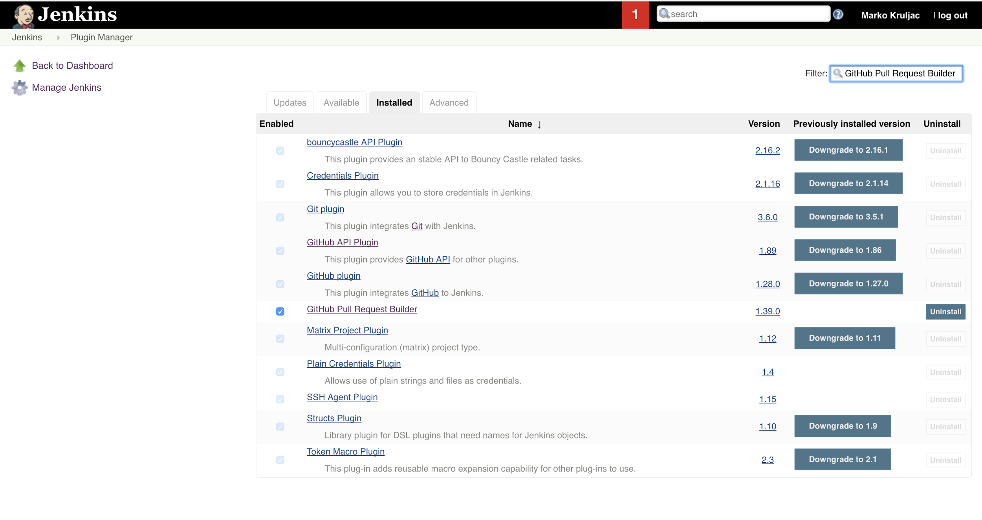

Slide 12
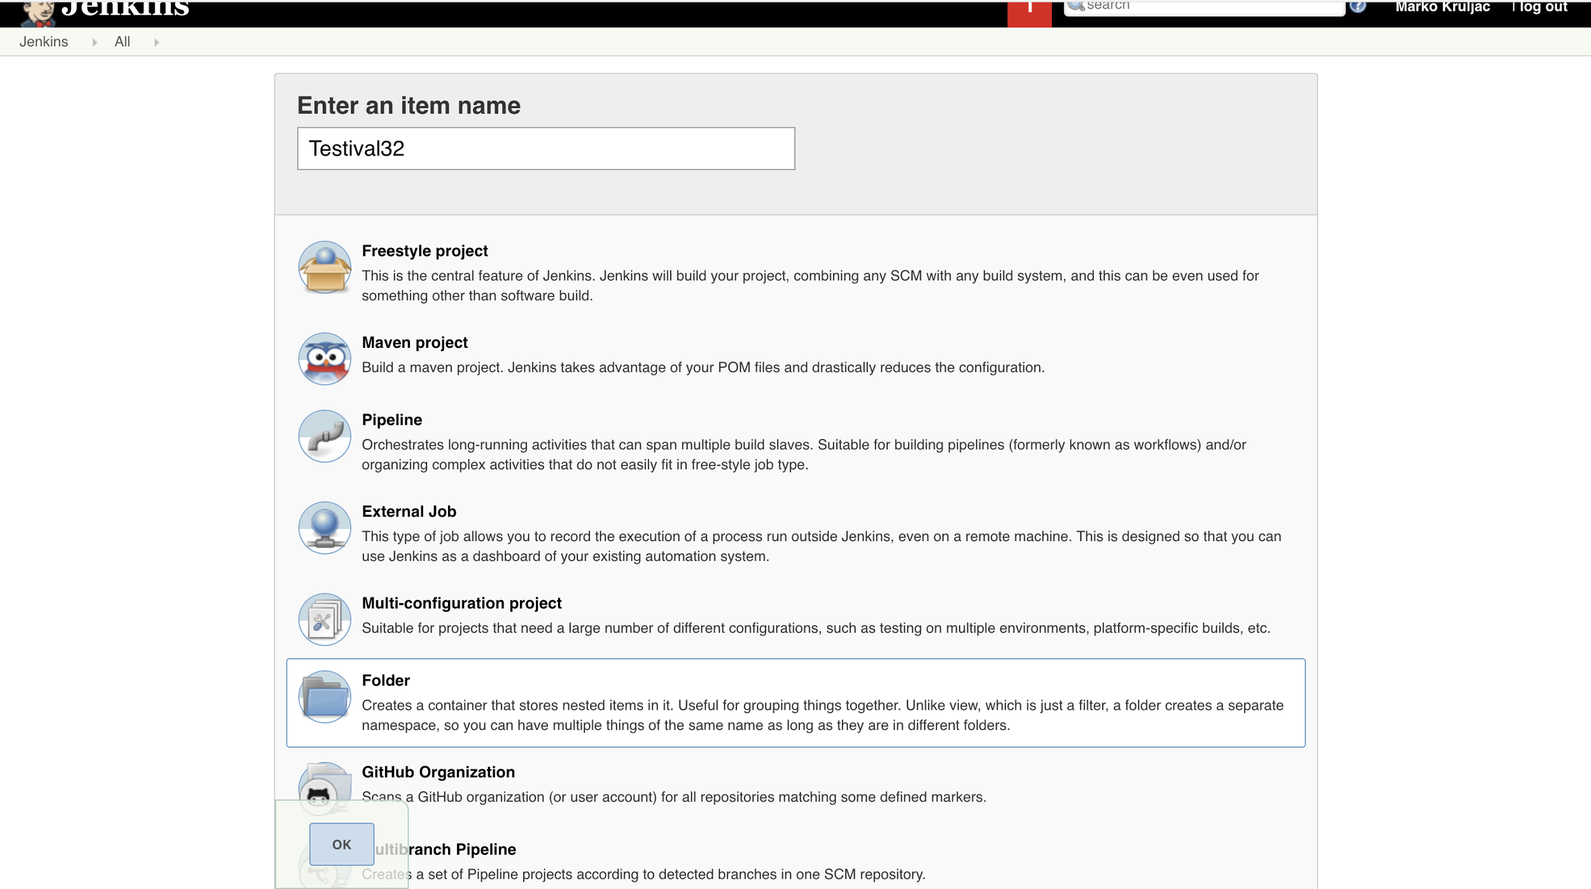

Slide 13
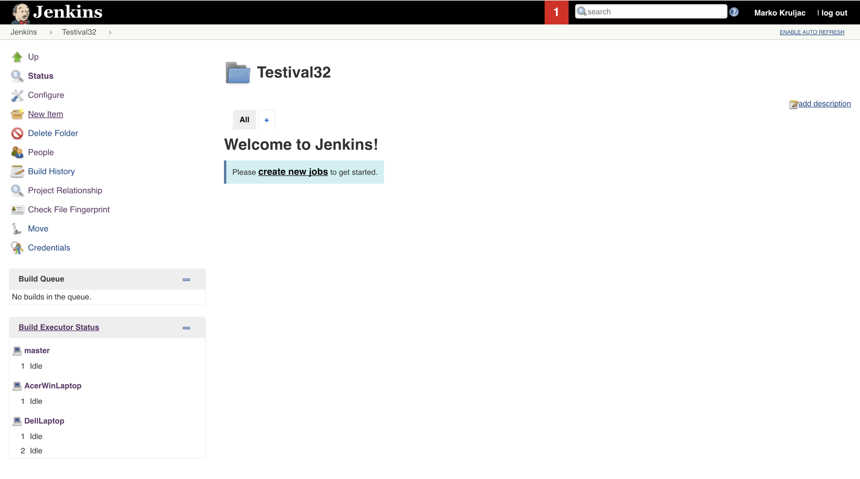

Slide 14
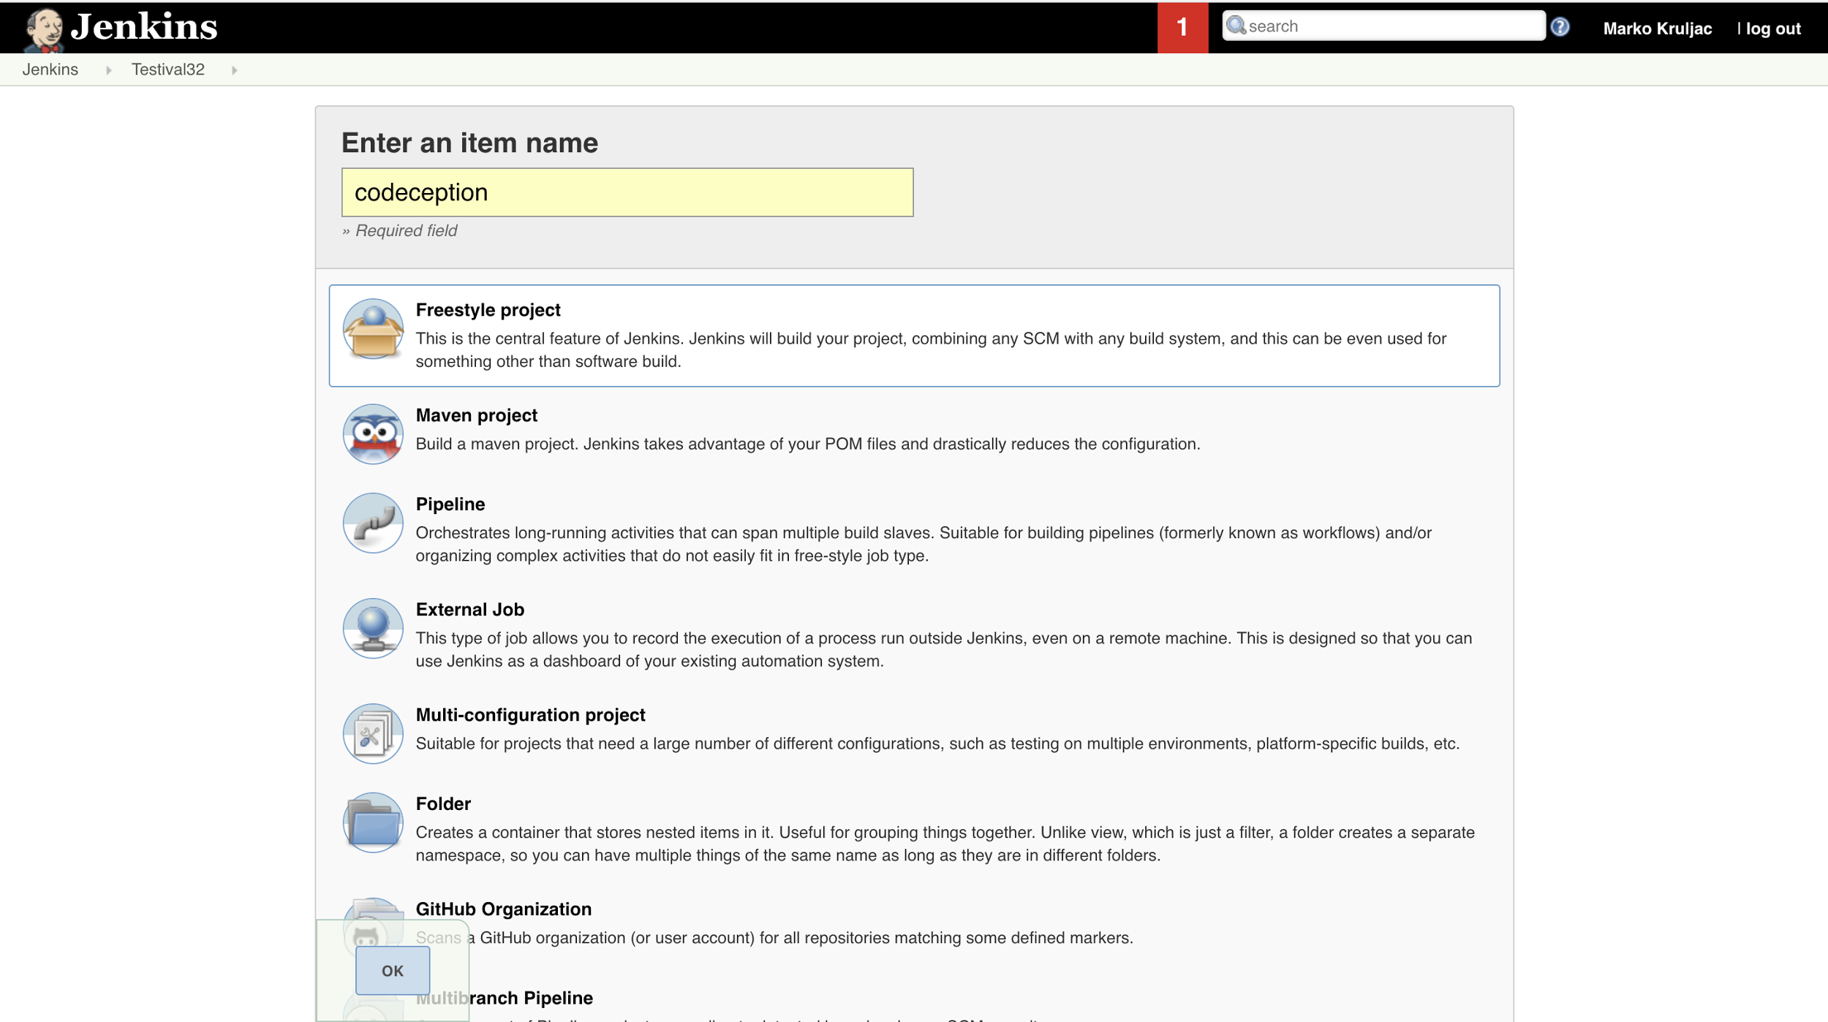


Slide 15
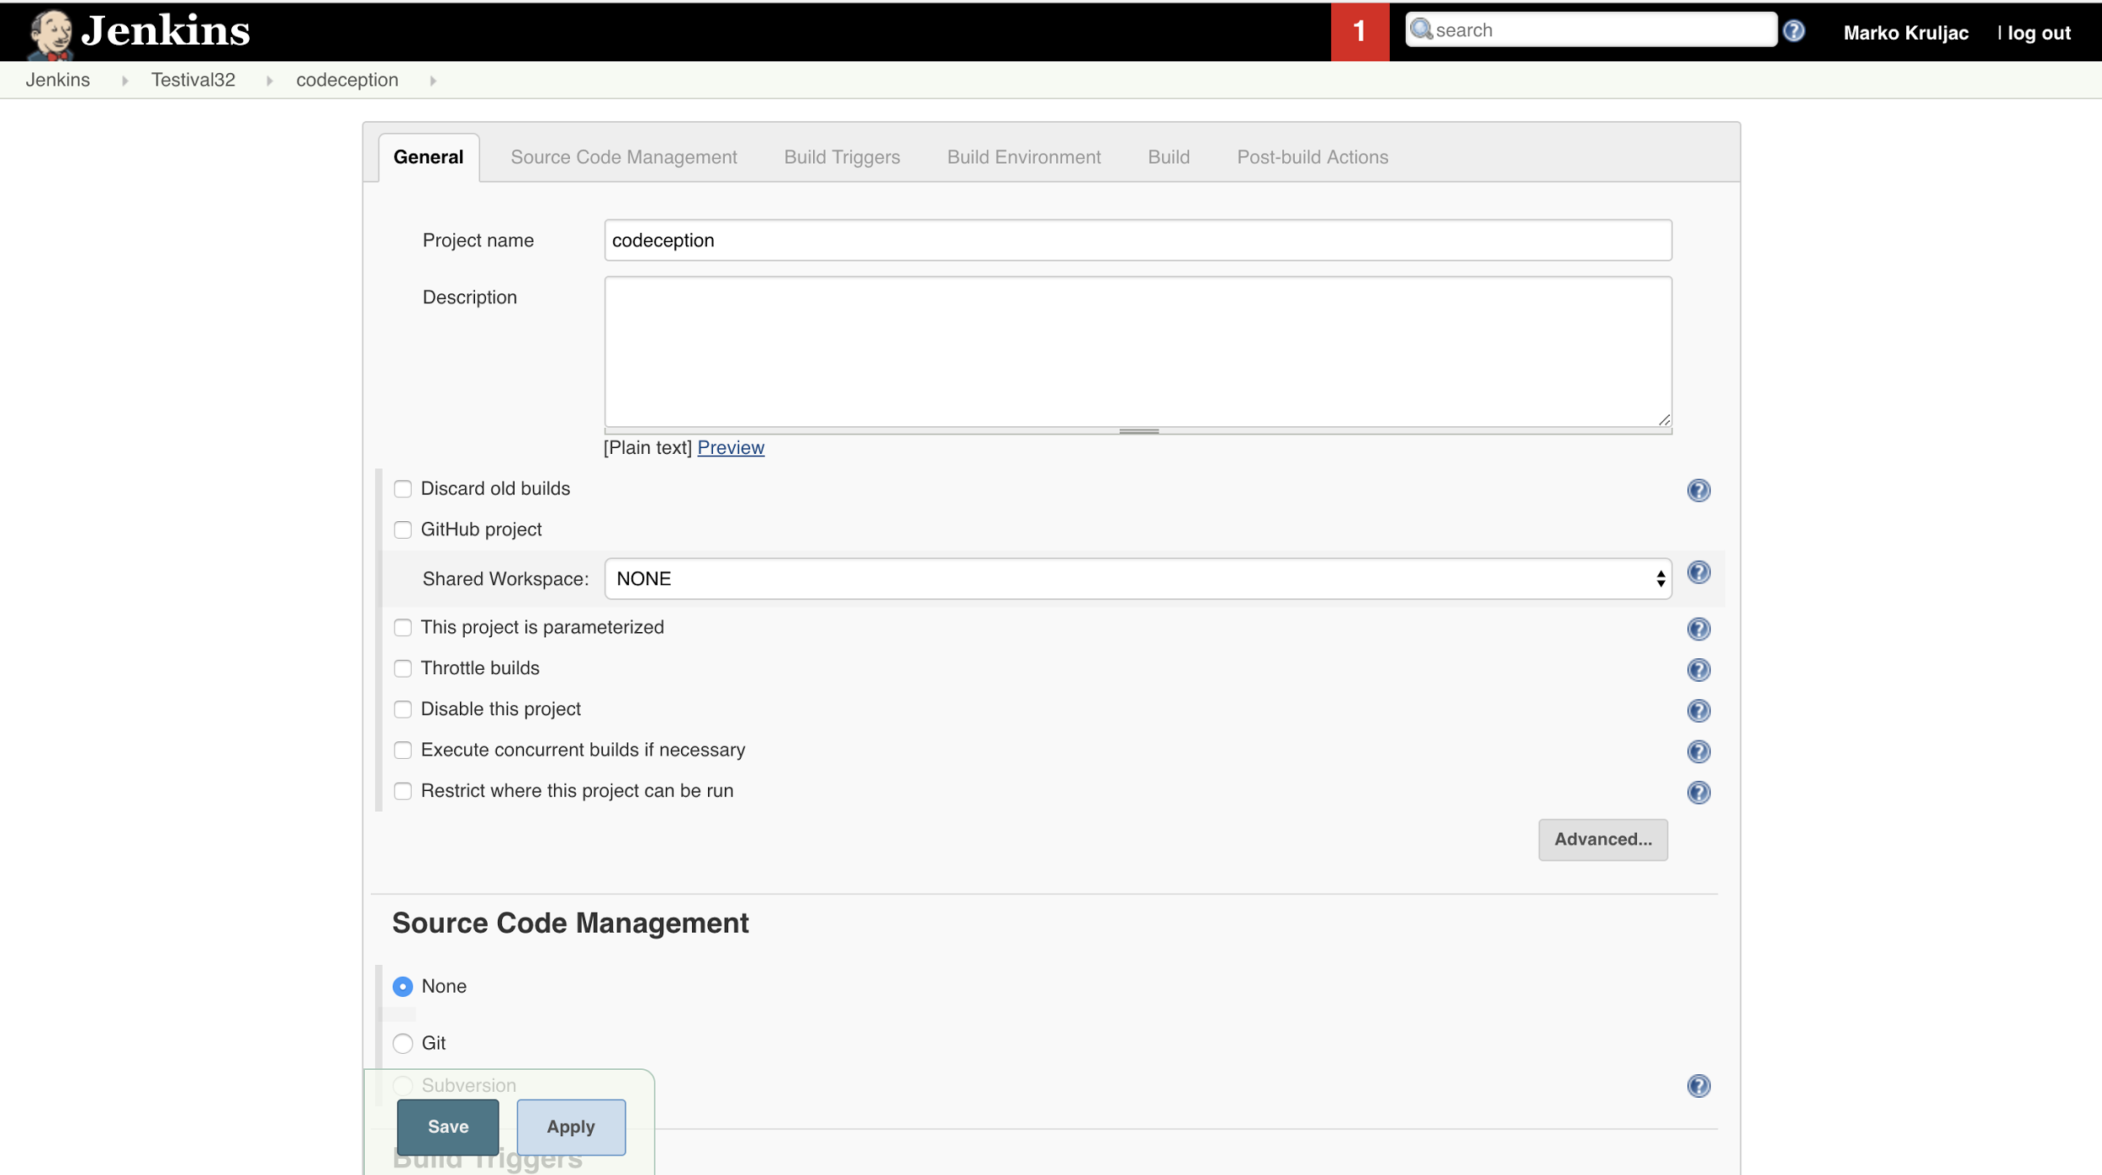

Slide 16
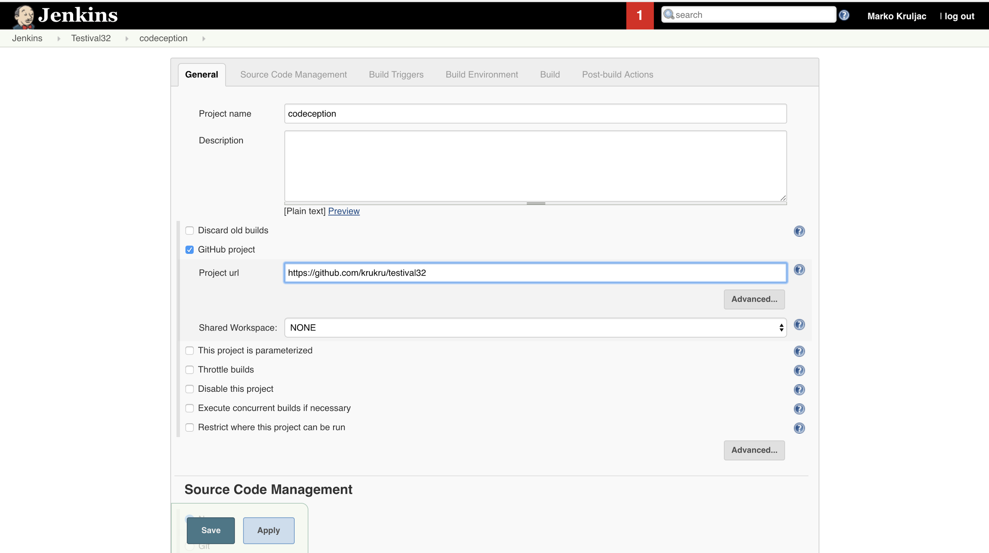

Slide 17
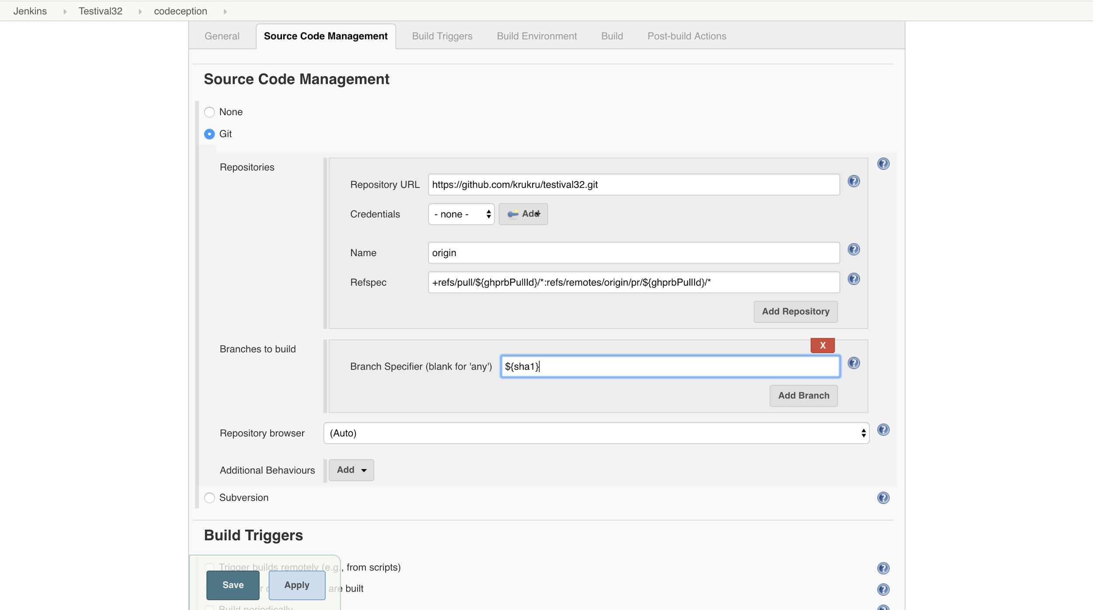

Slide 18
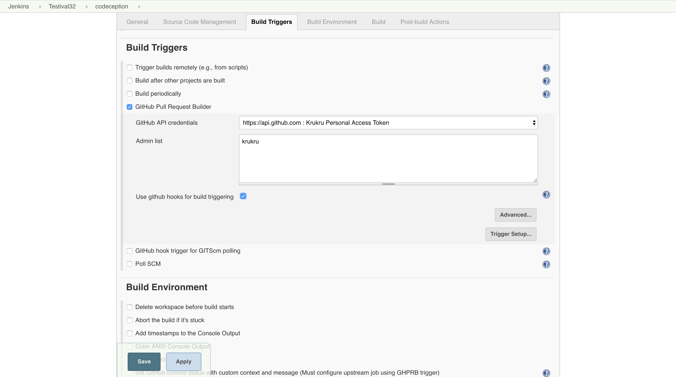

Slide 19
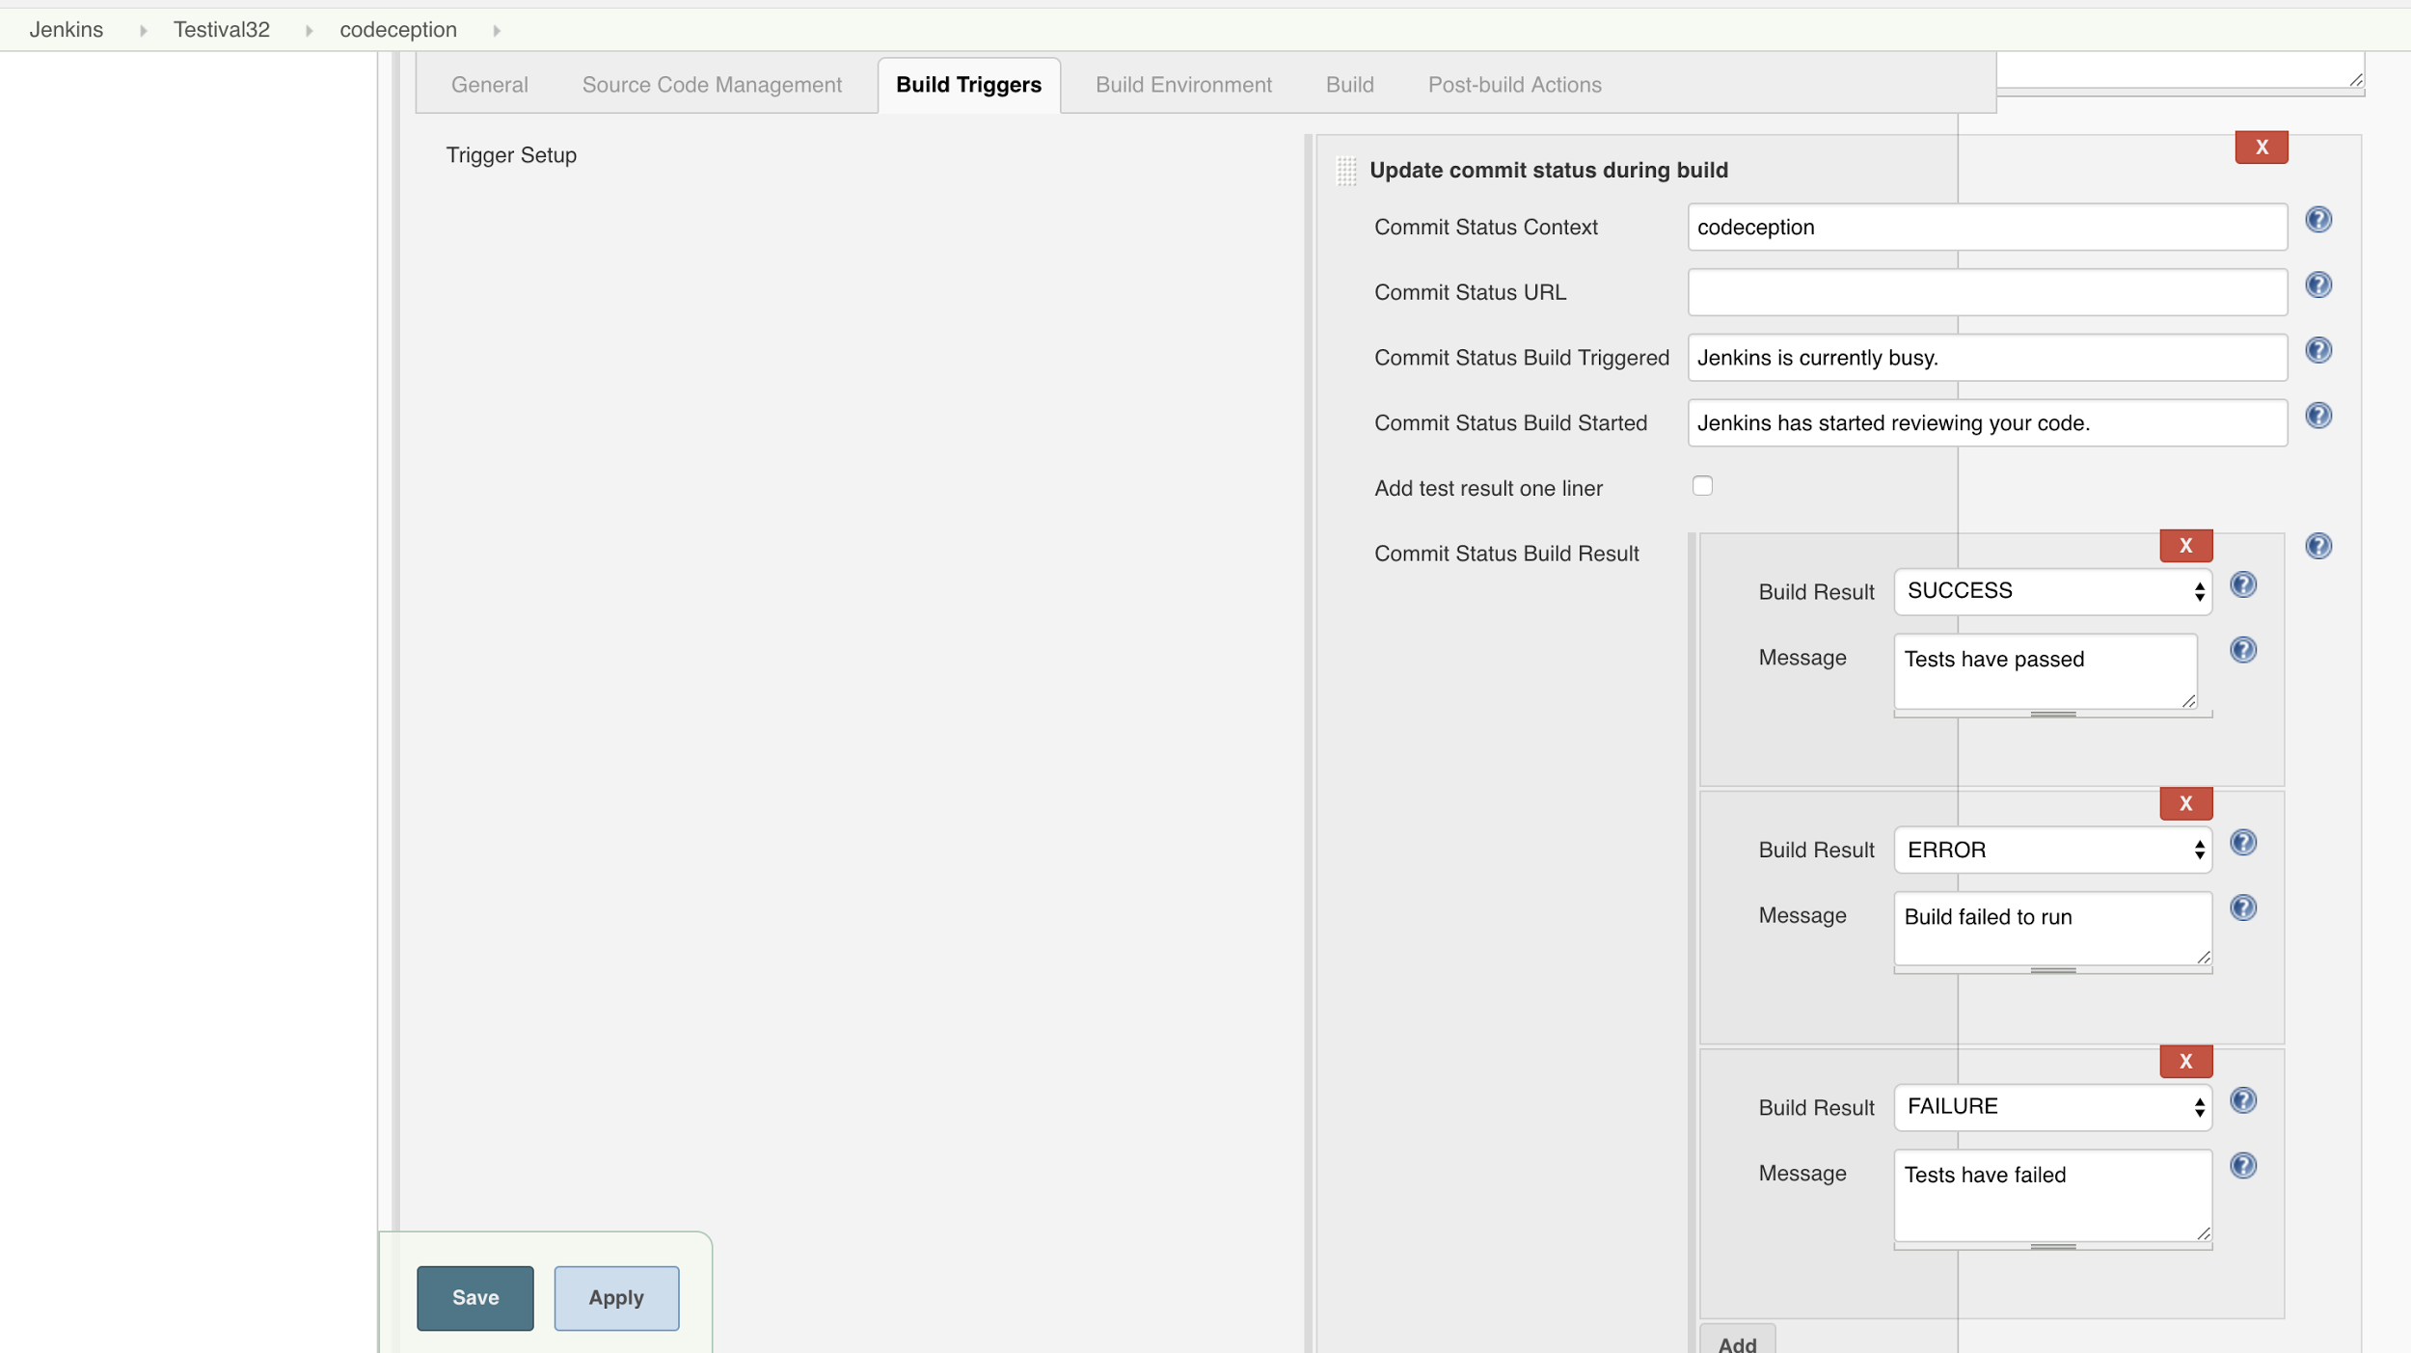

Slide 20
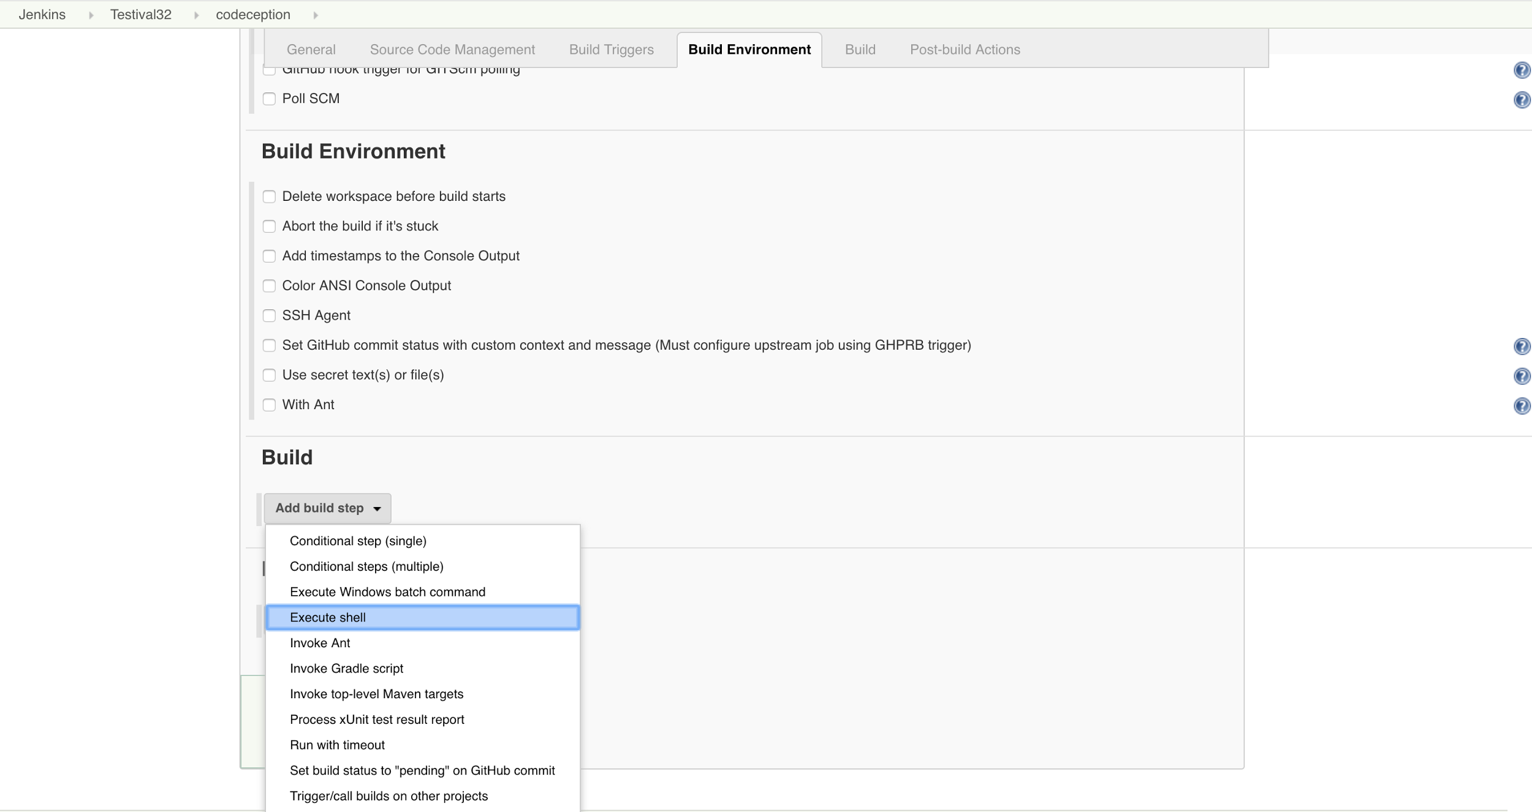

Slide 21
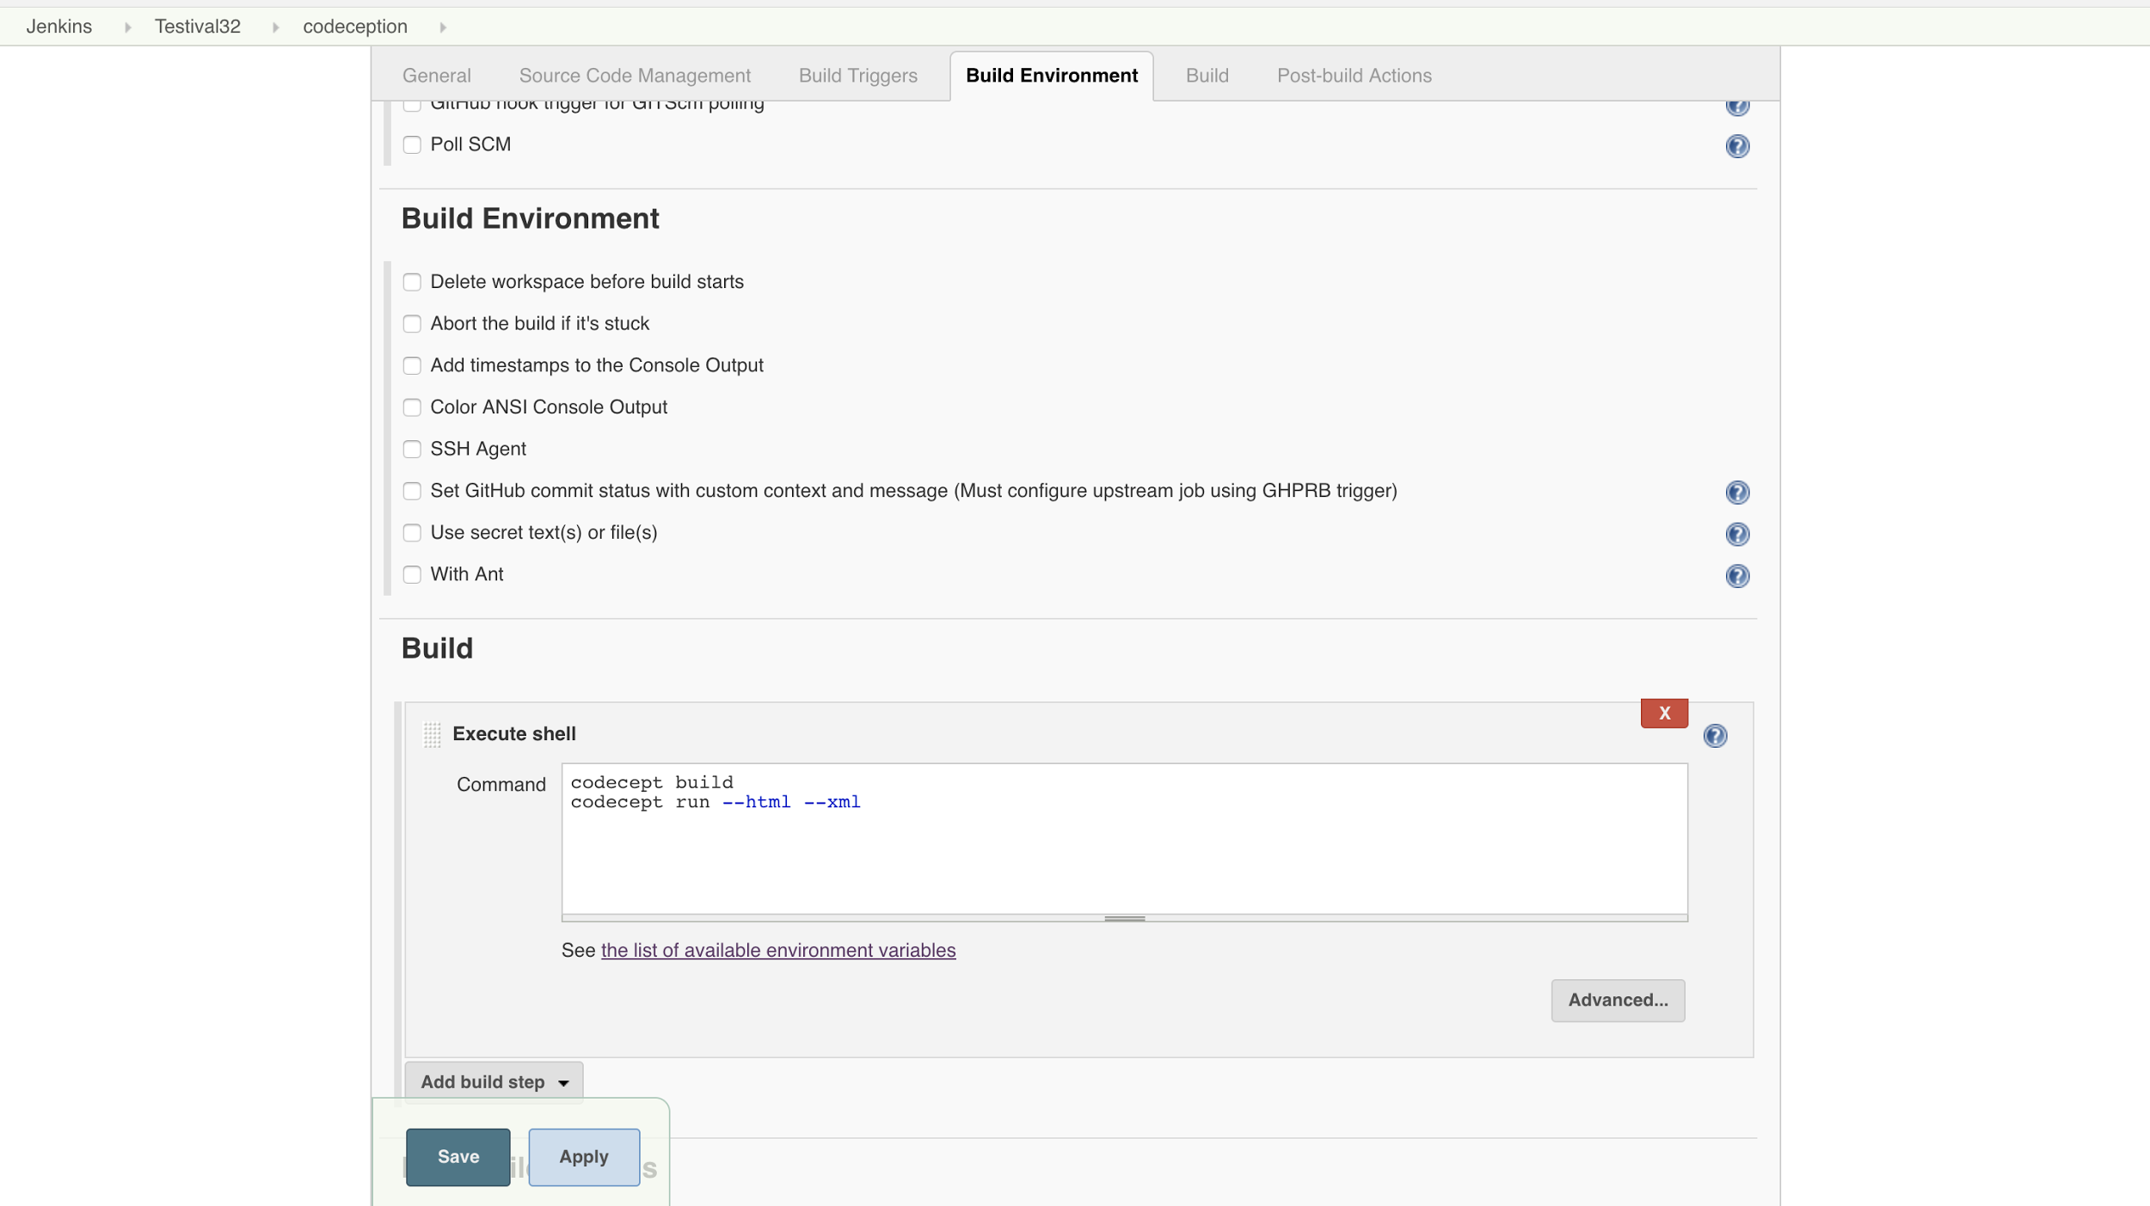

Slide 22
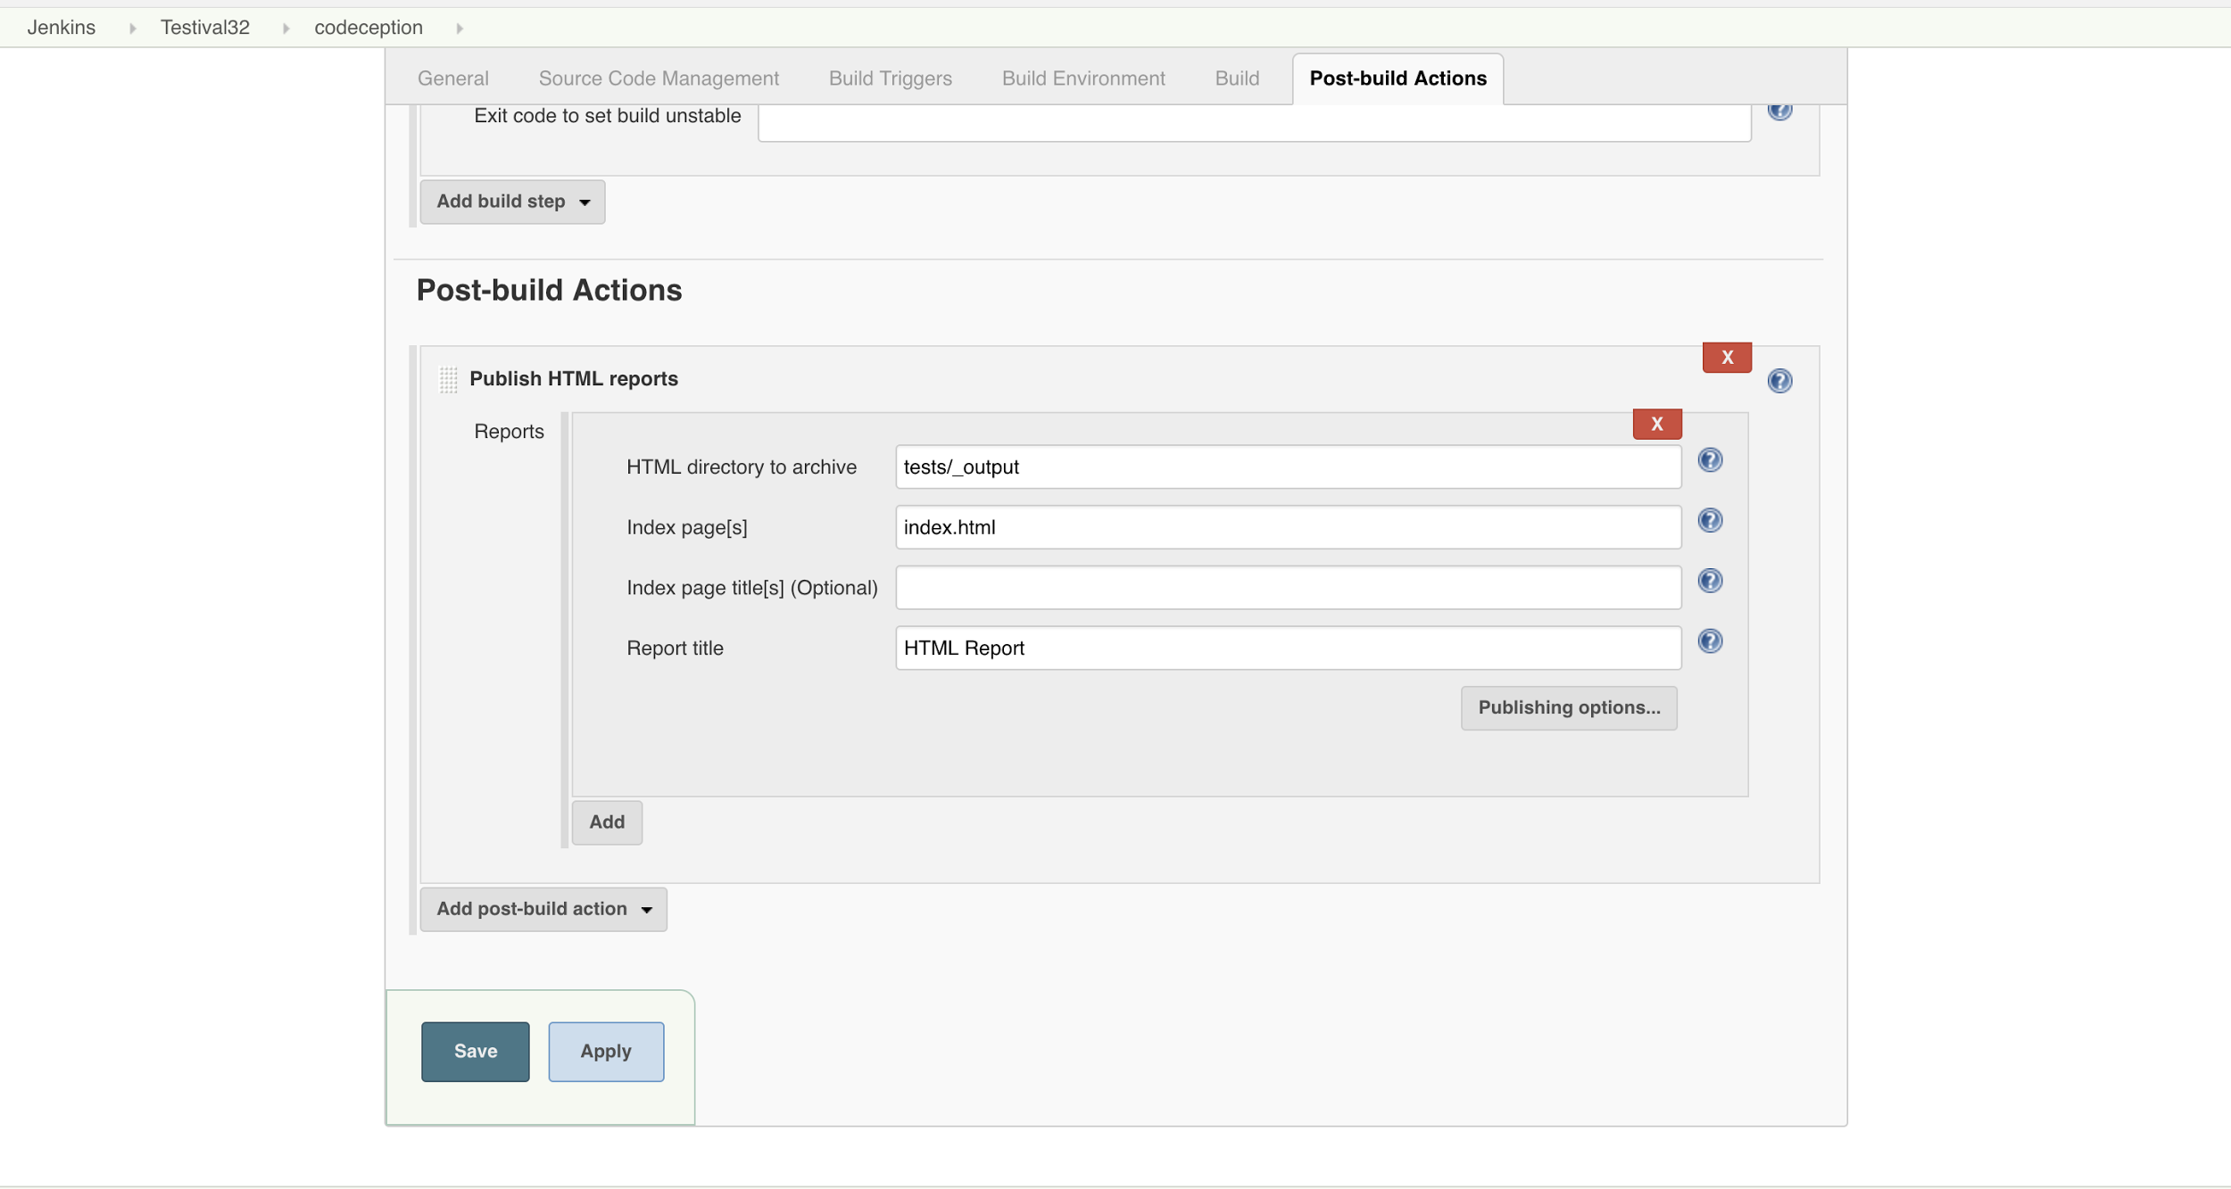

Slide 23
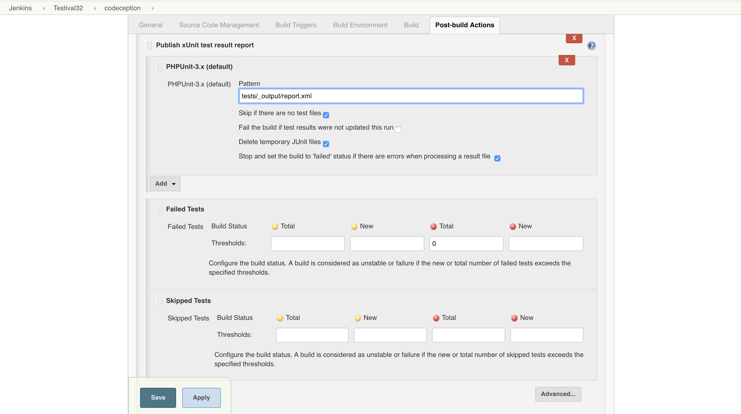

Slide 24
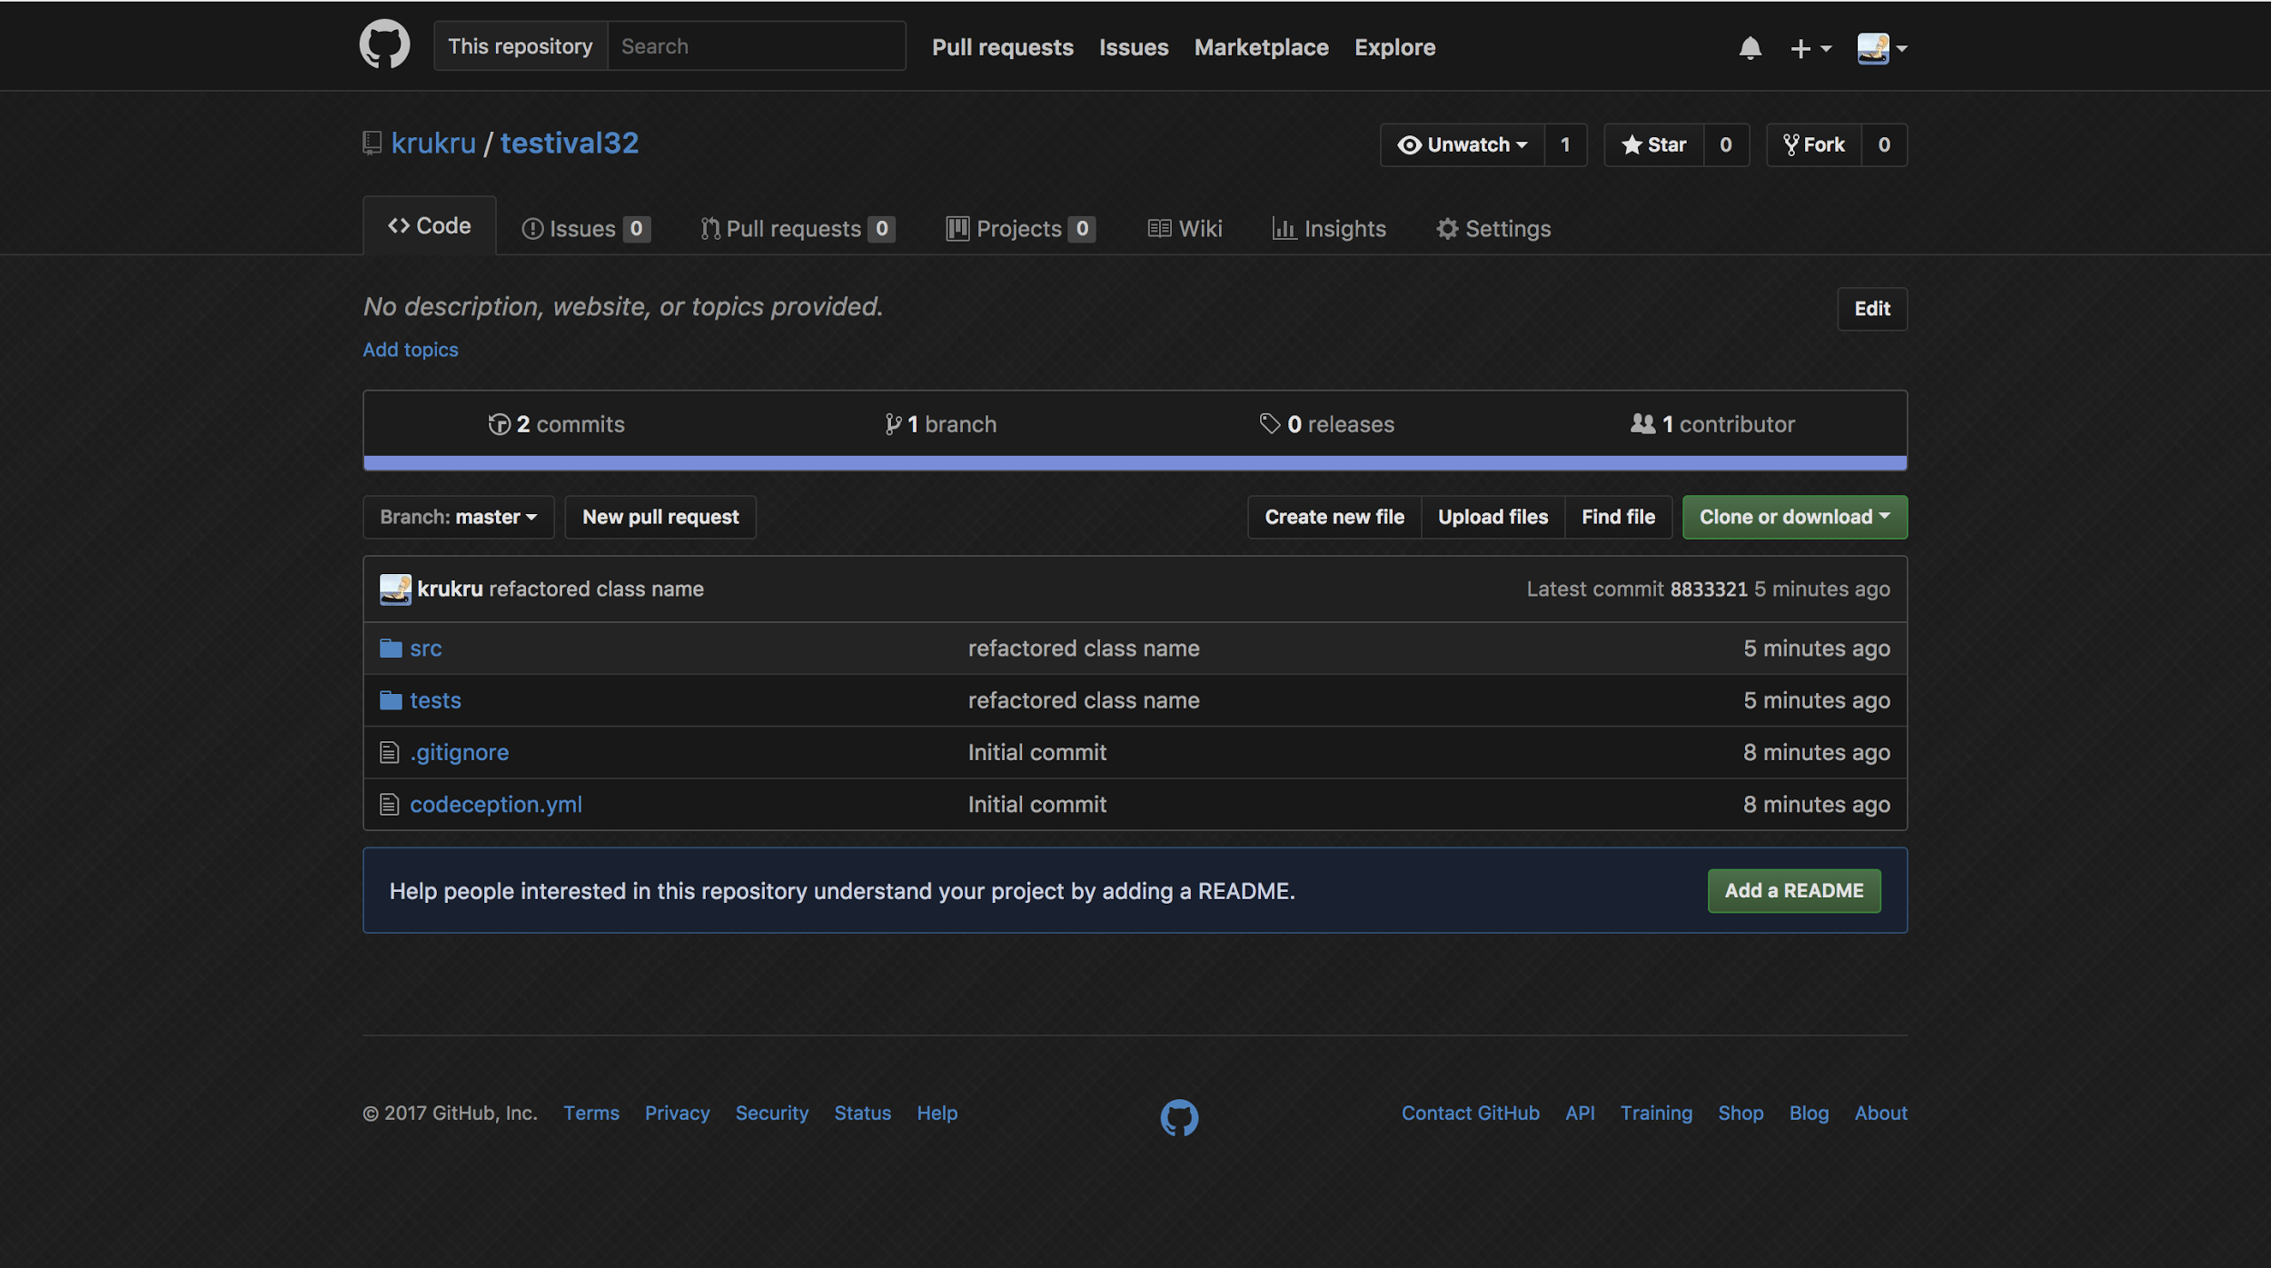

Slide 25
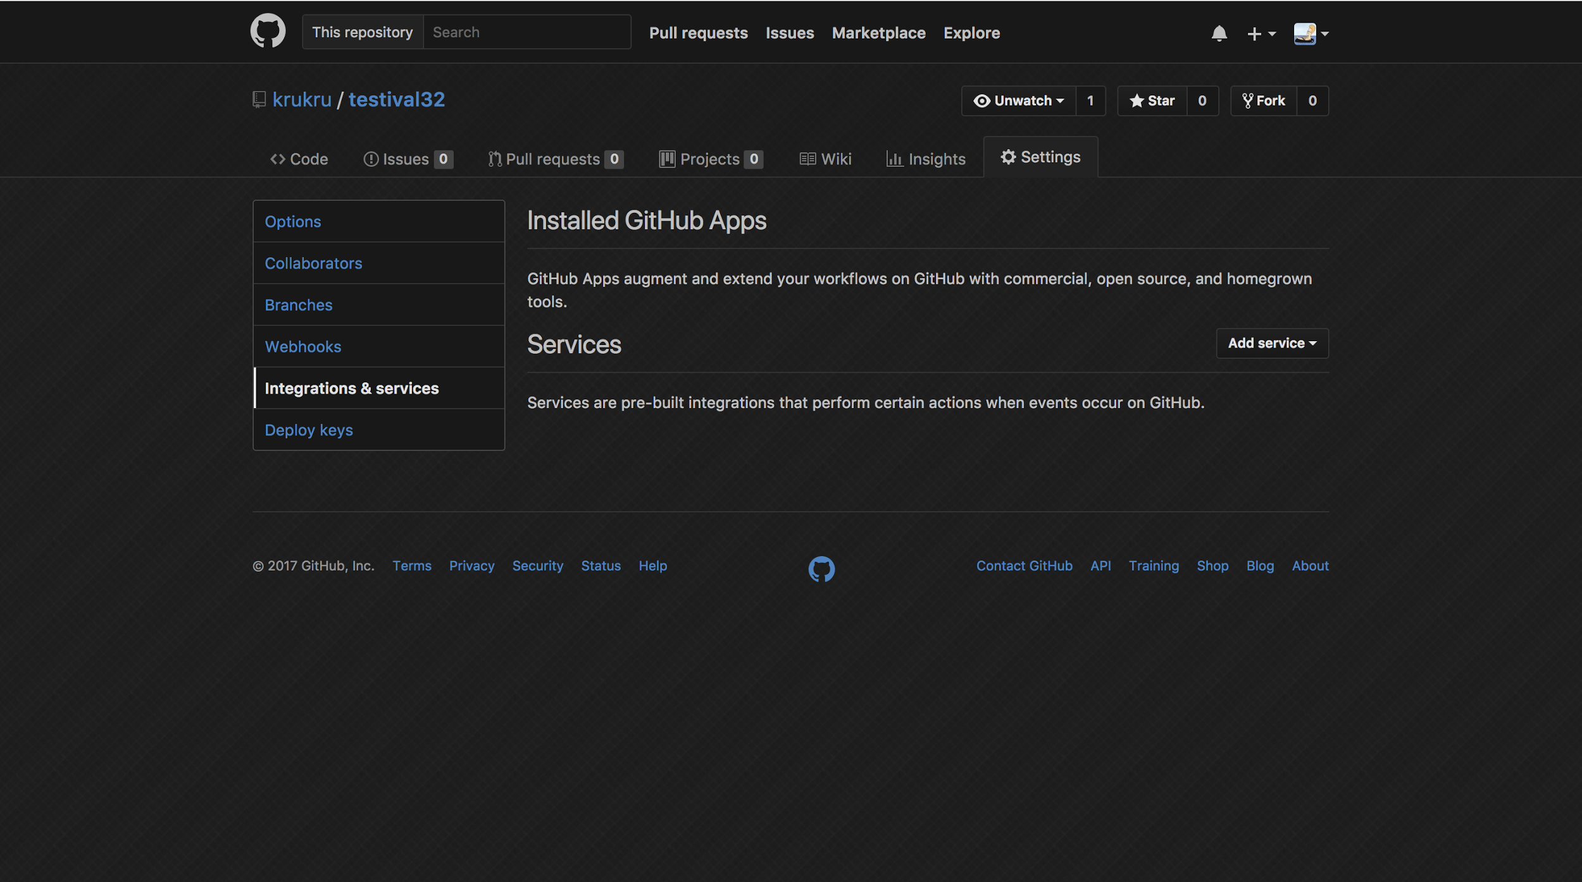

Slide 26
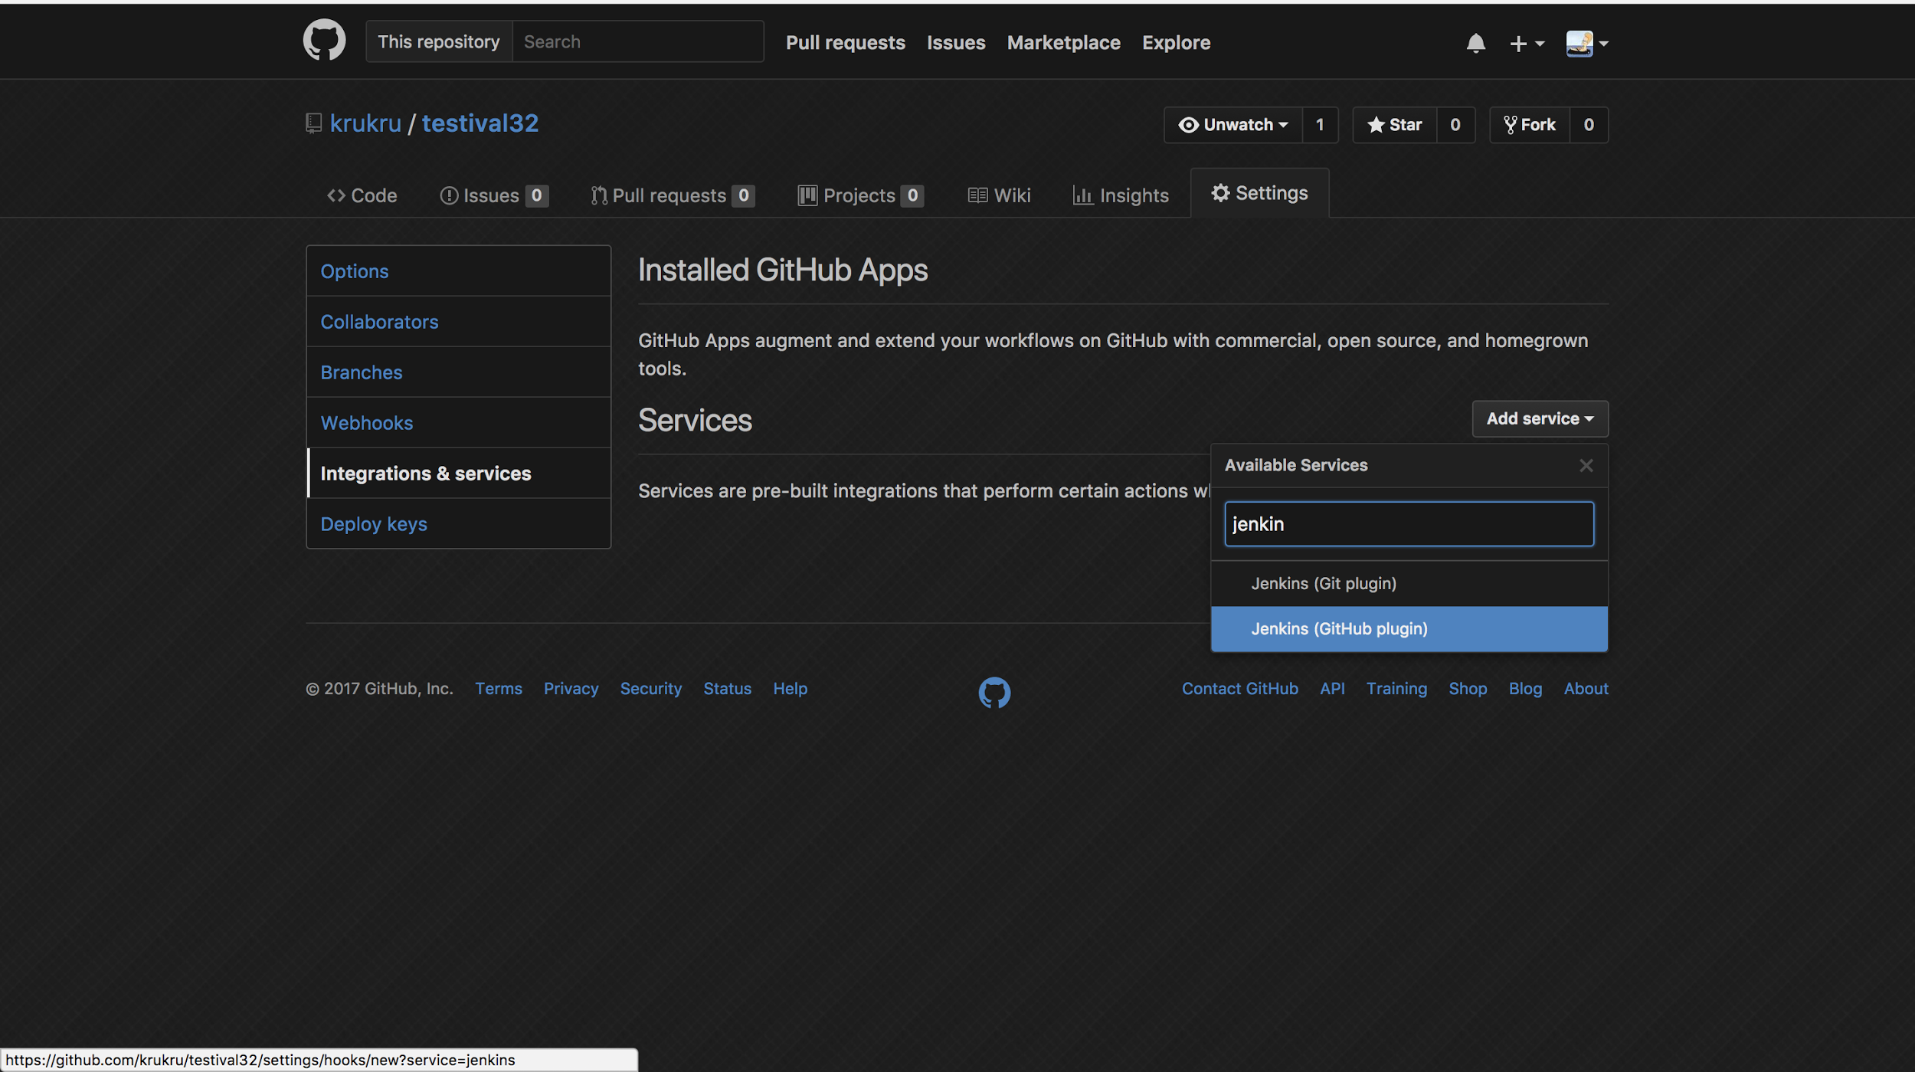

Slide 27
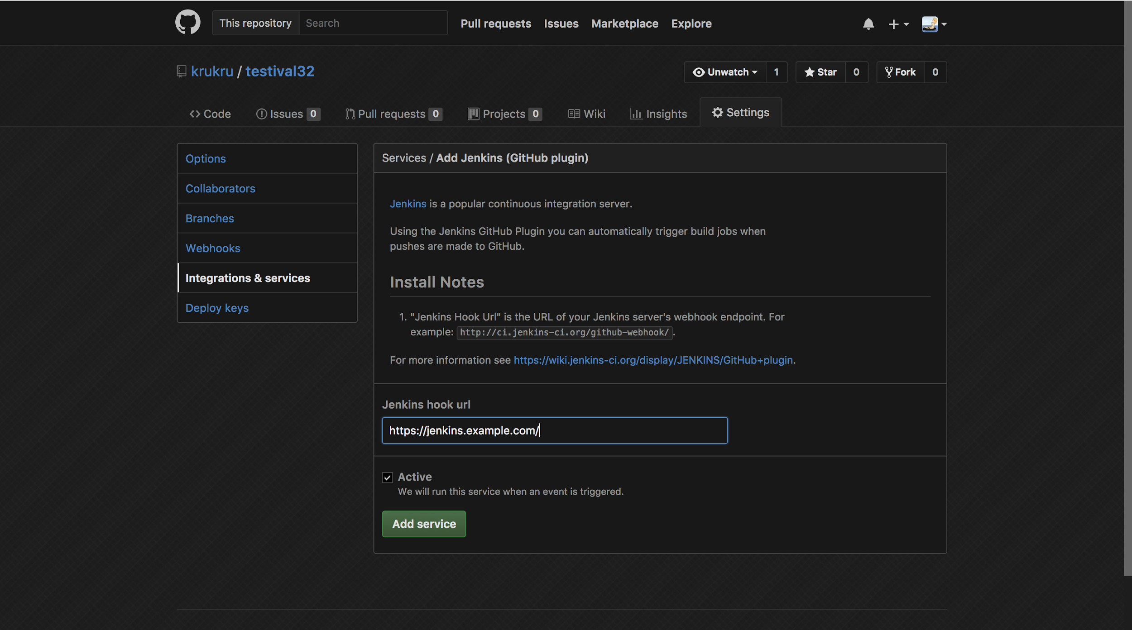

Slide 28
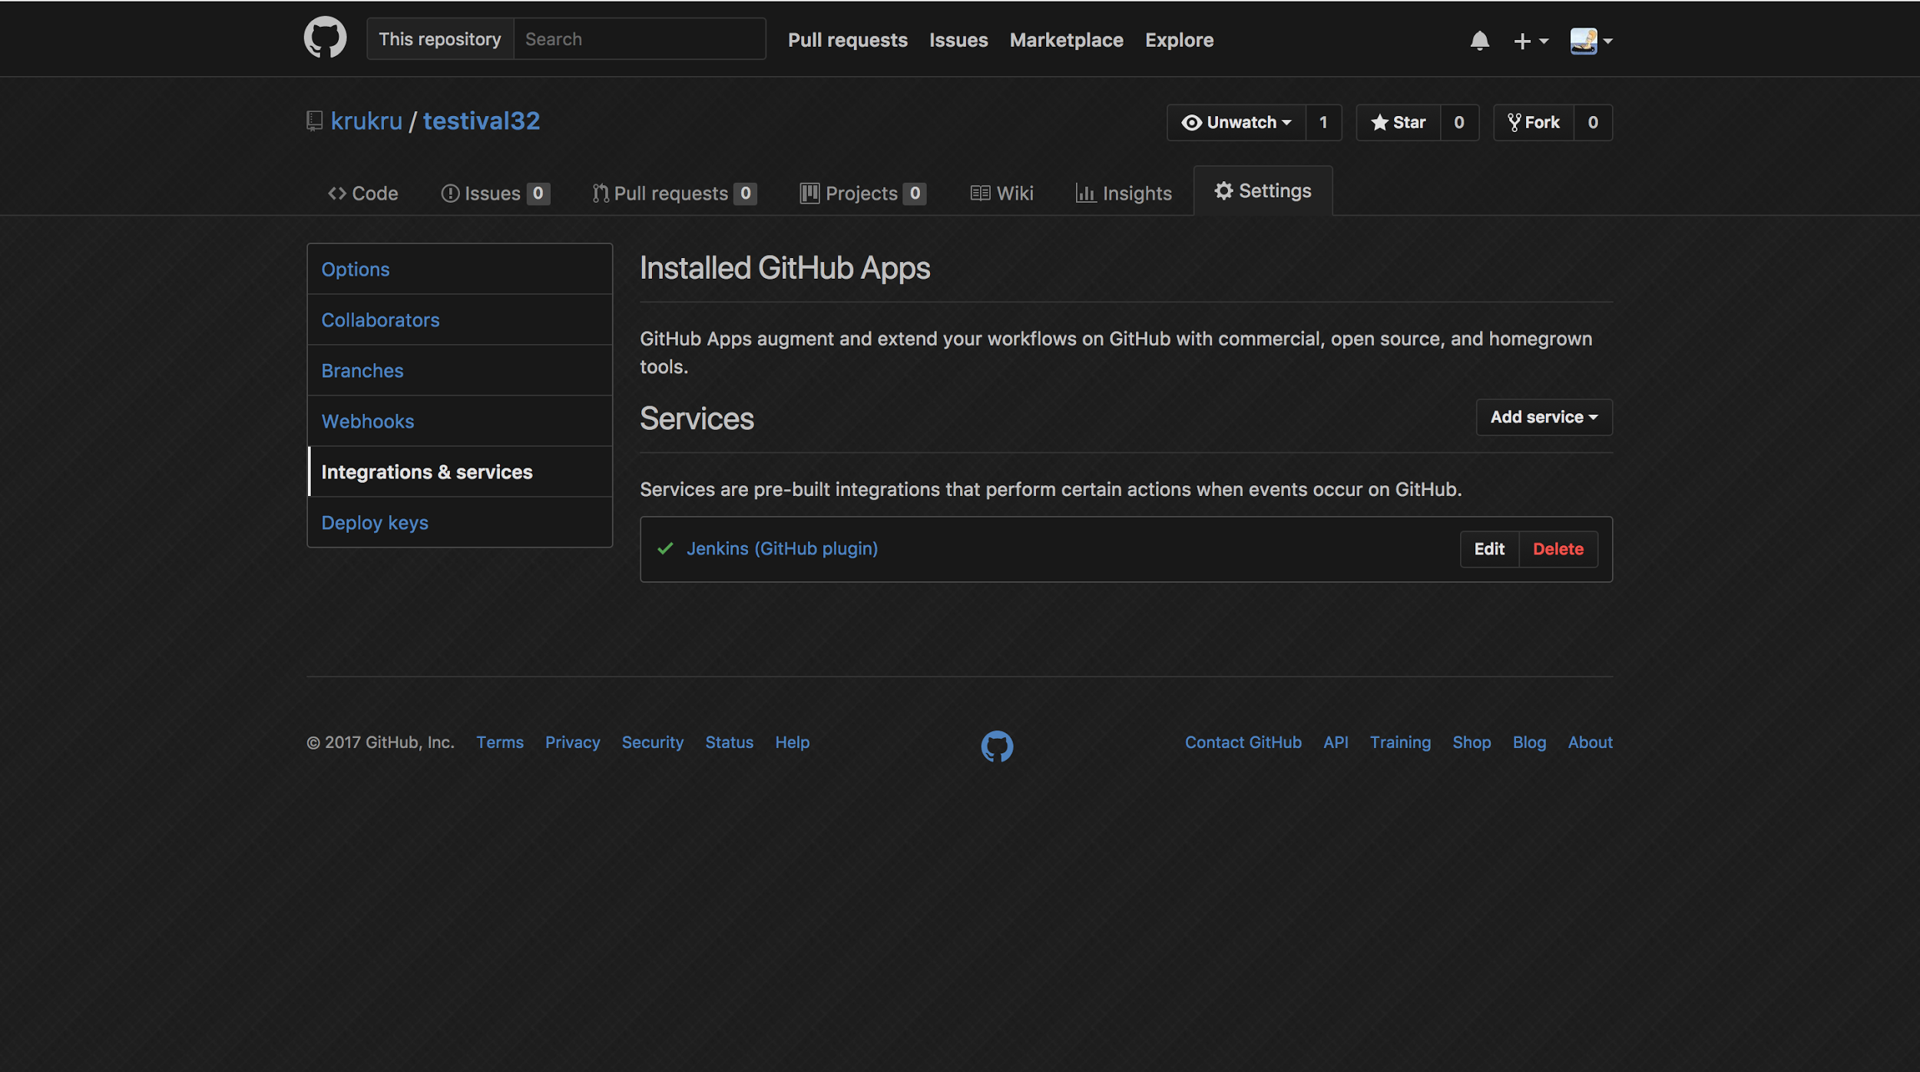

Slide 30
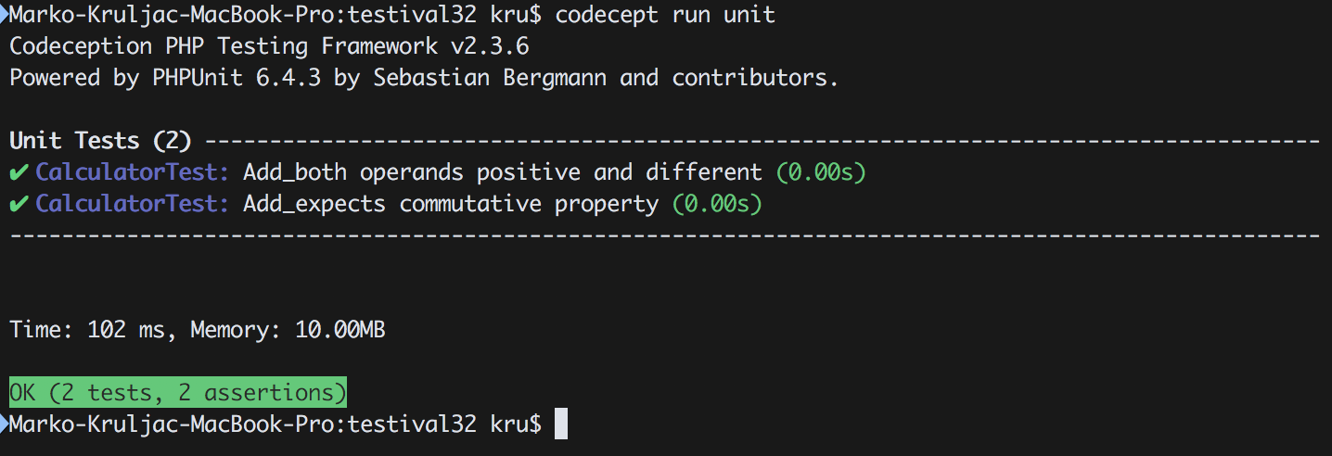

Slide 31
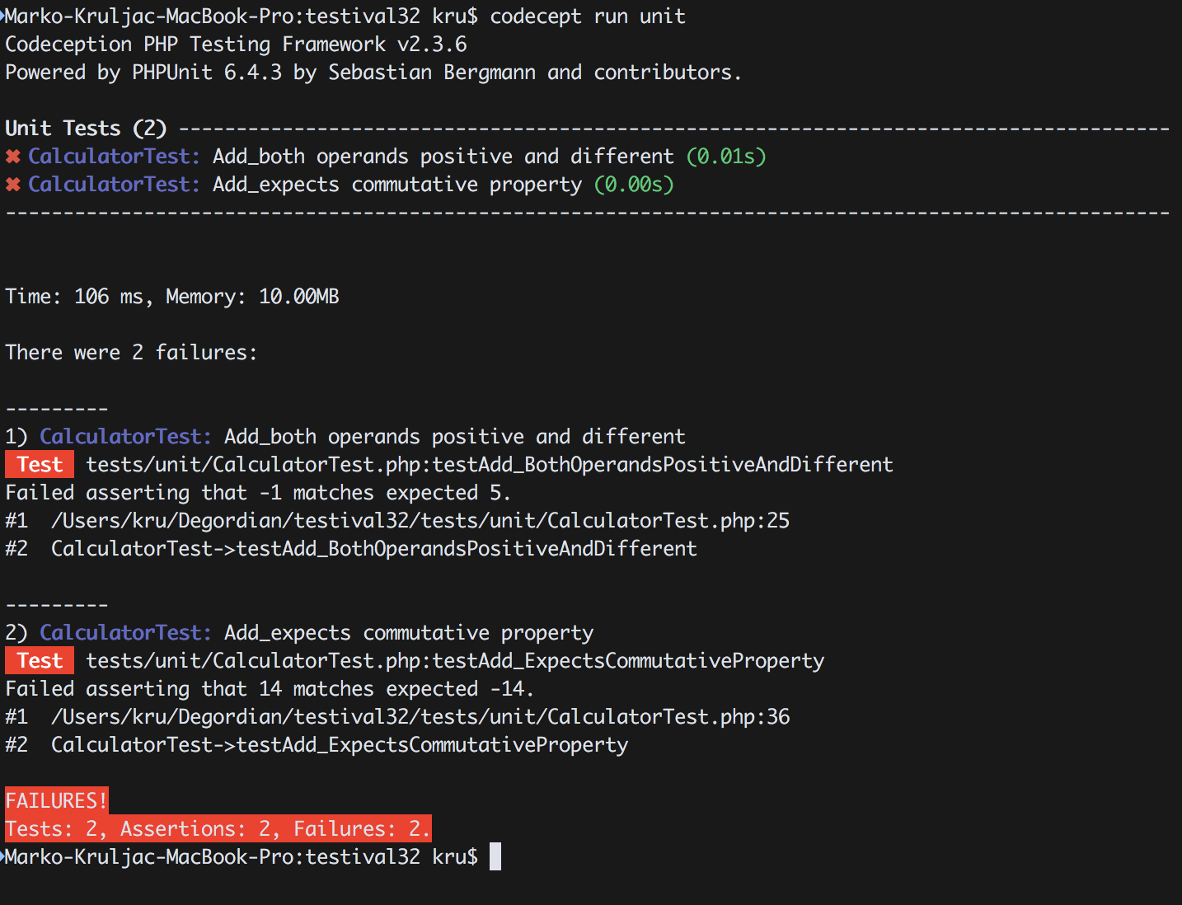

Slide 32
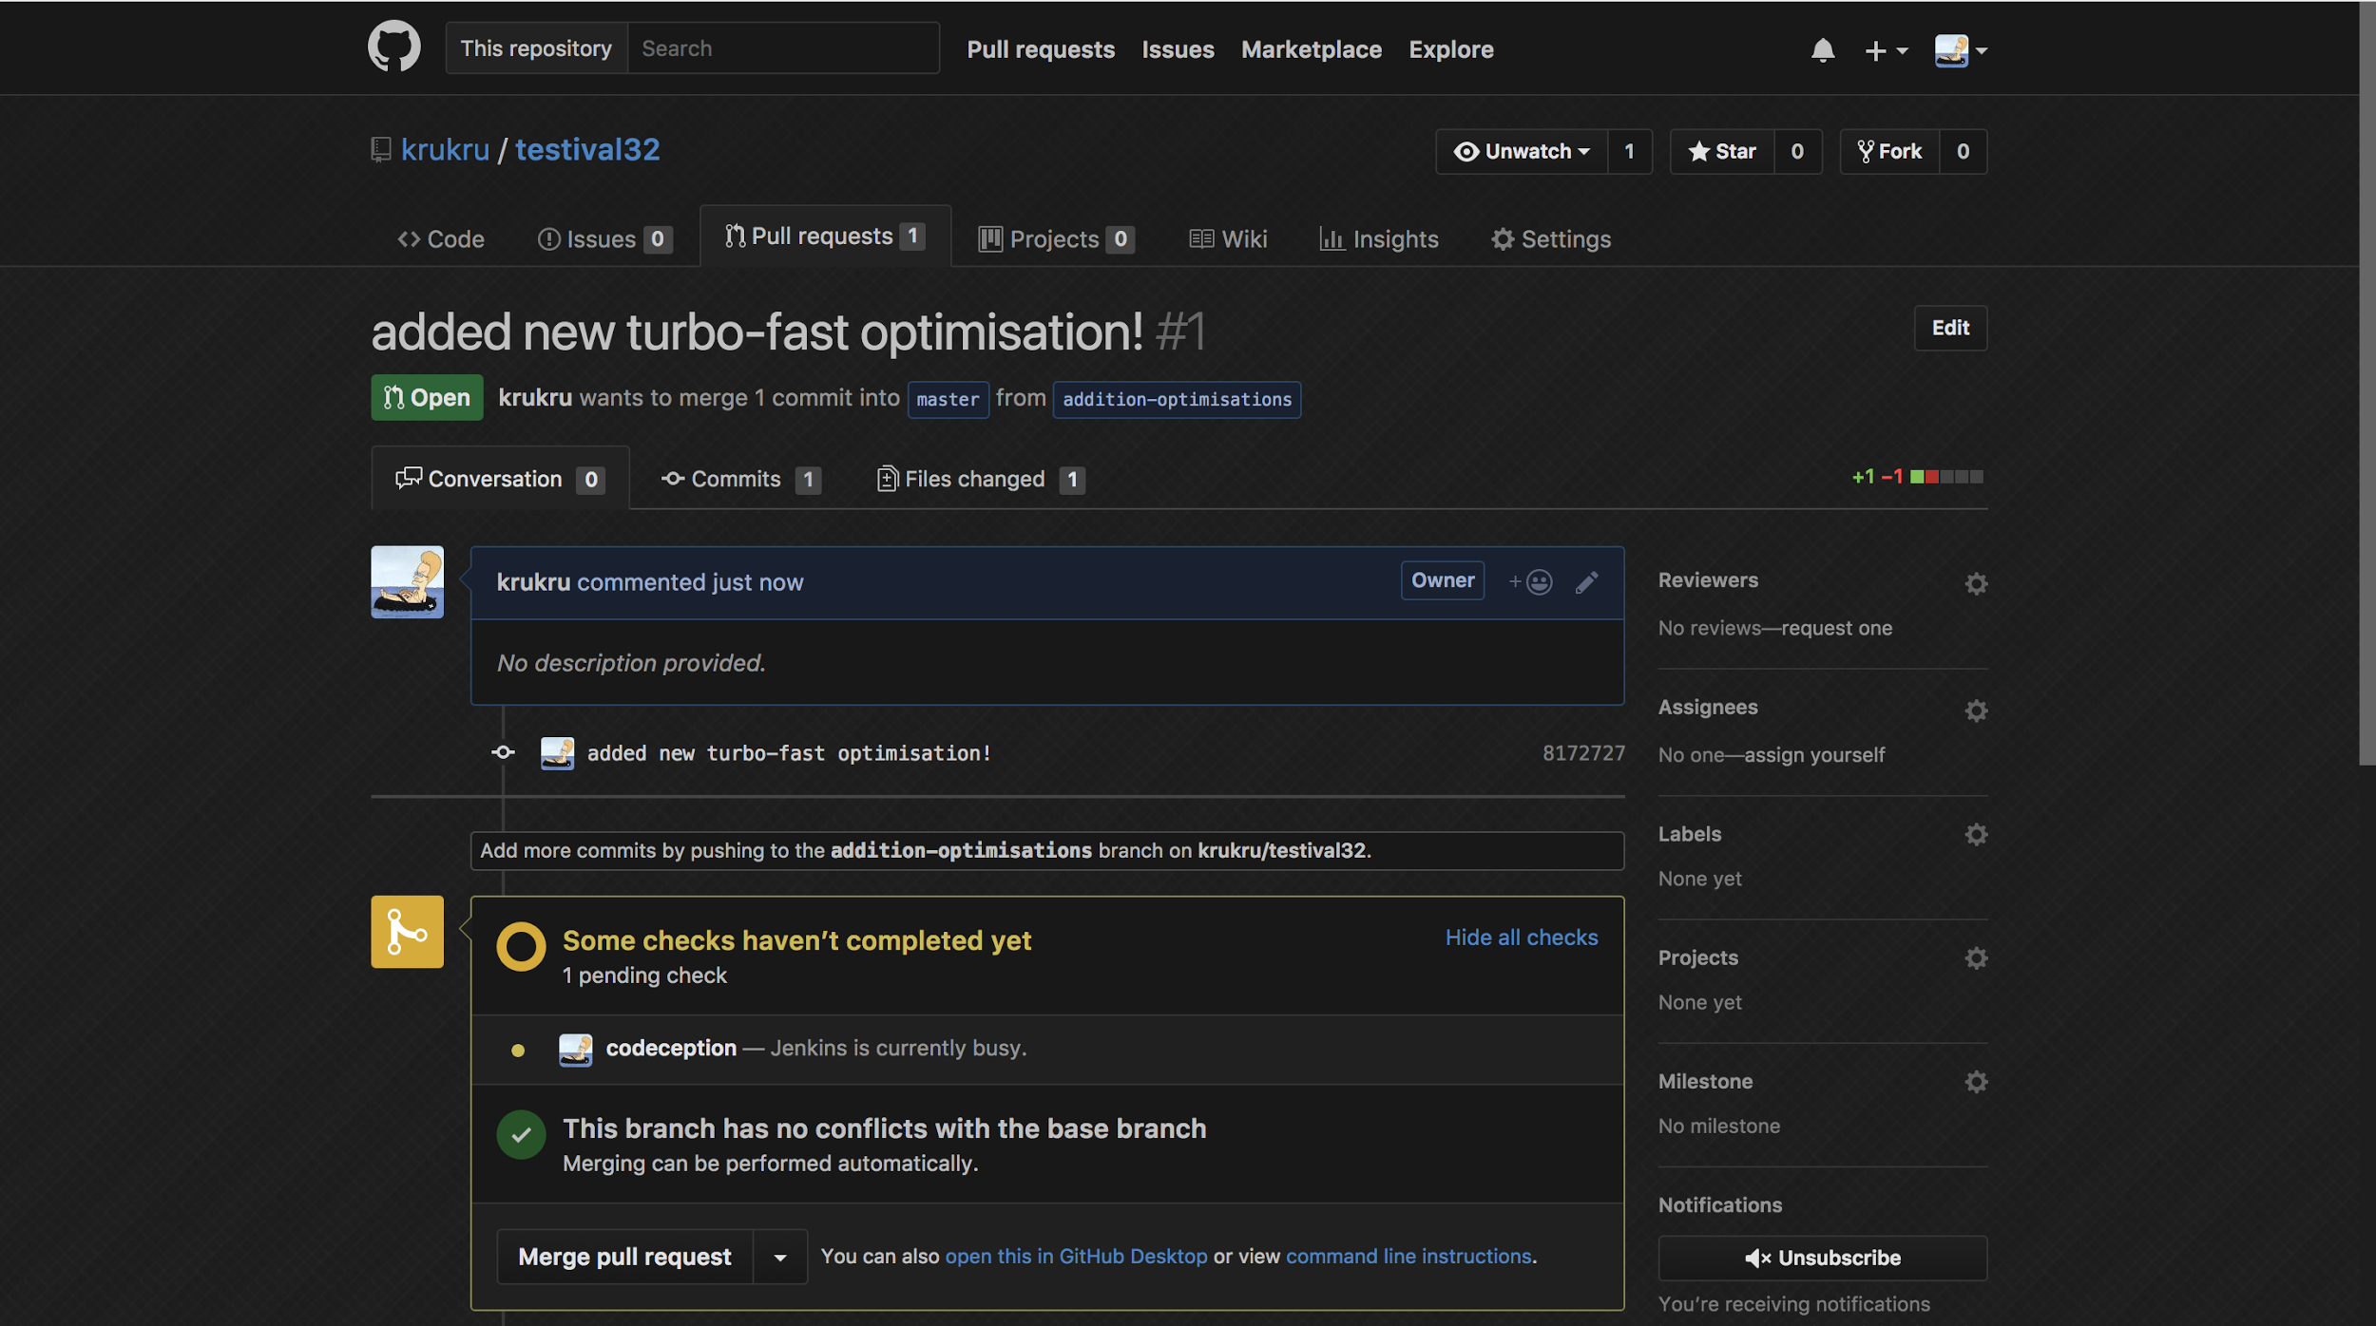

Slide 33
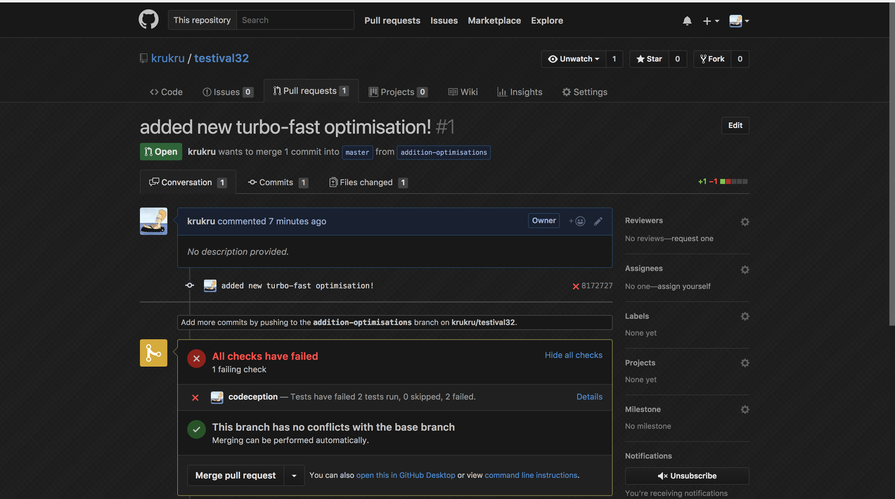

Slide 34
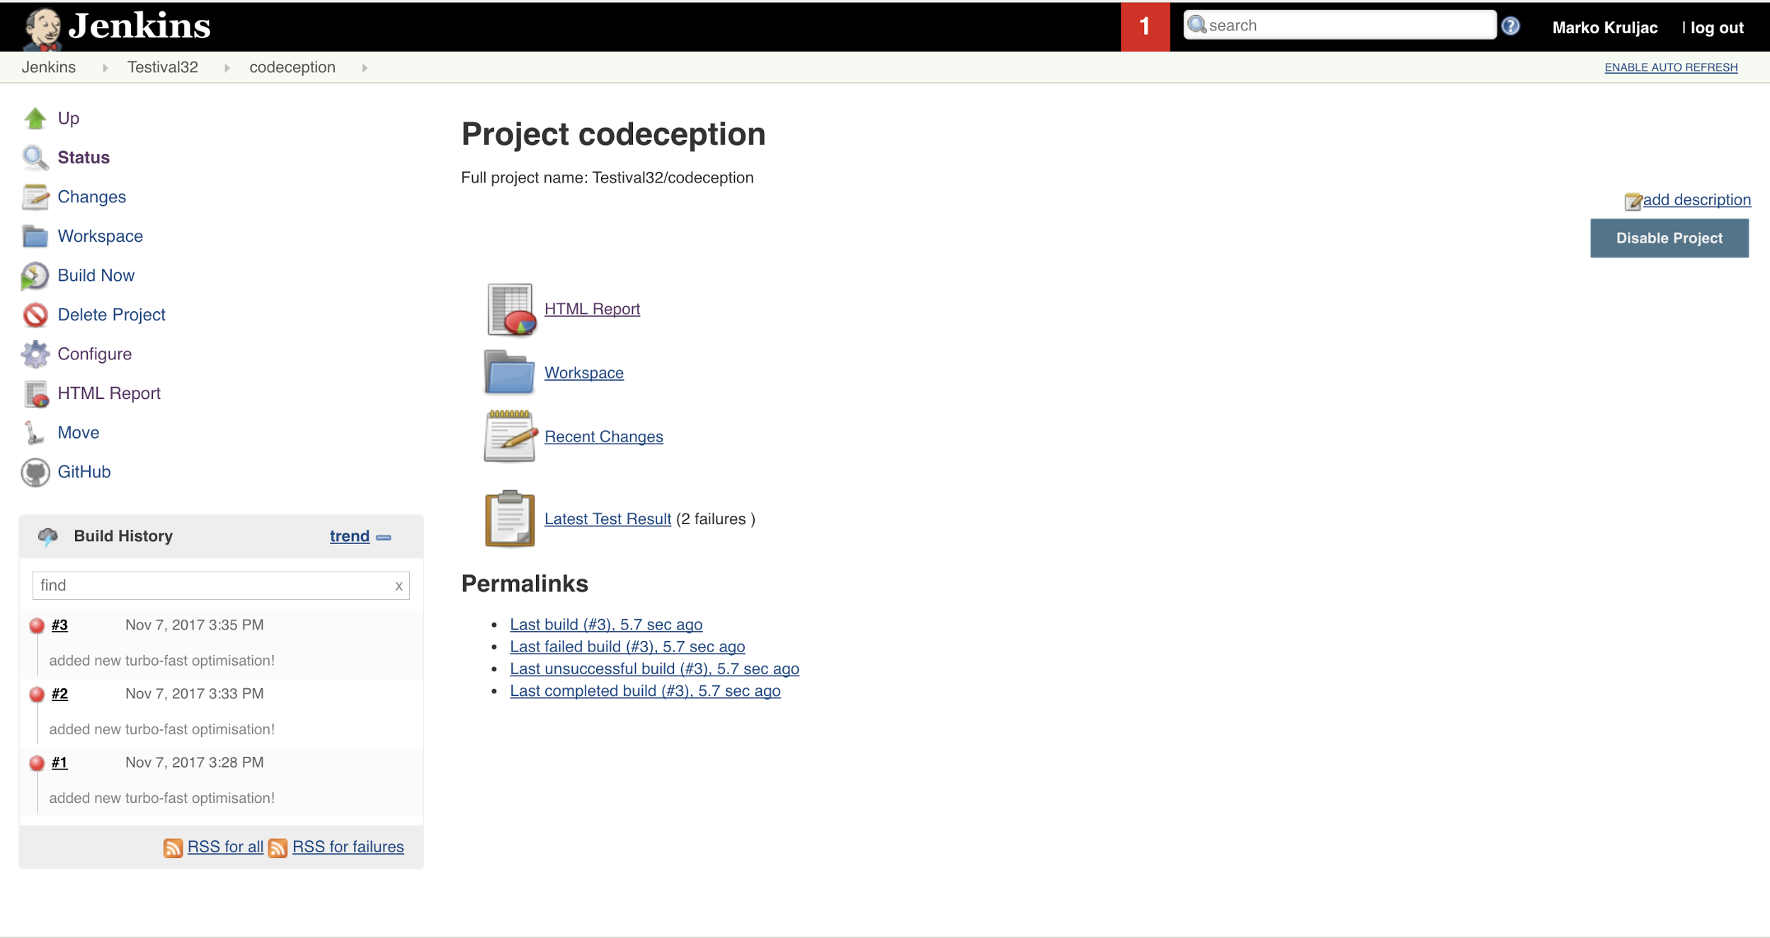

Slide 35
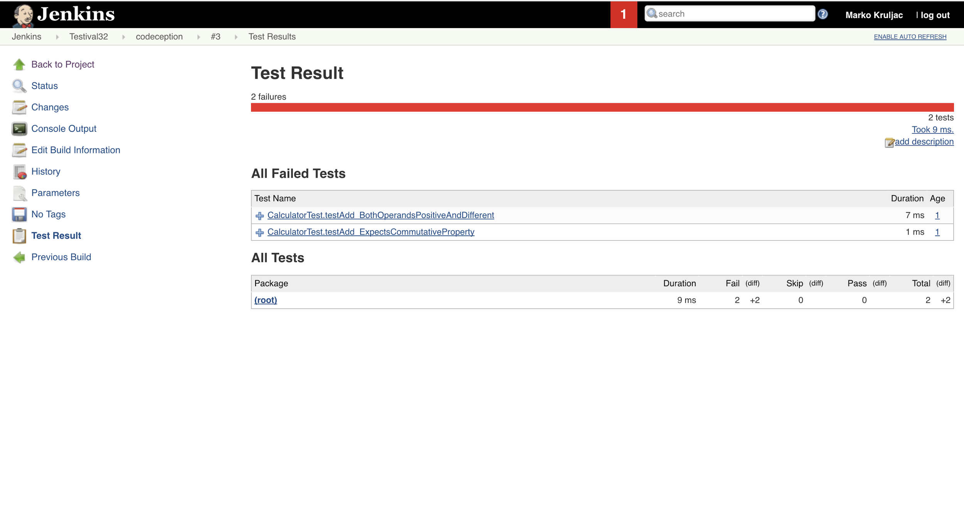

Slide 36
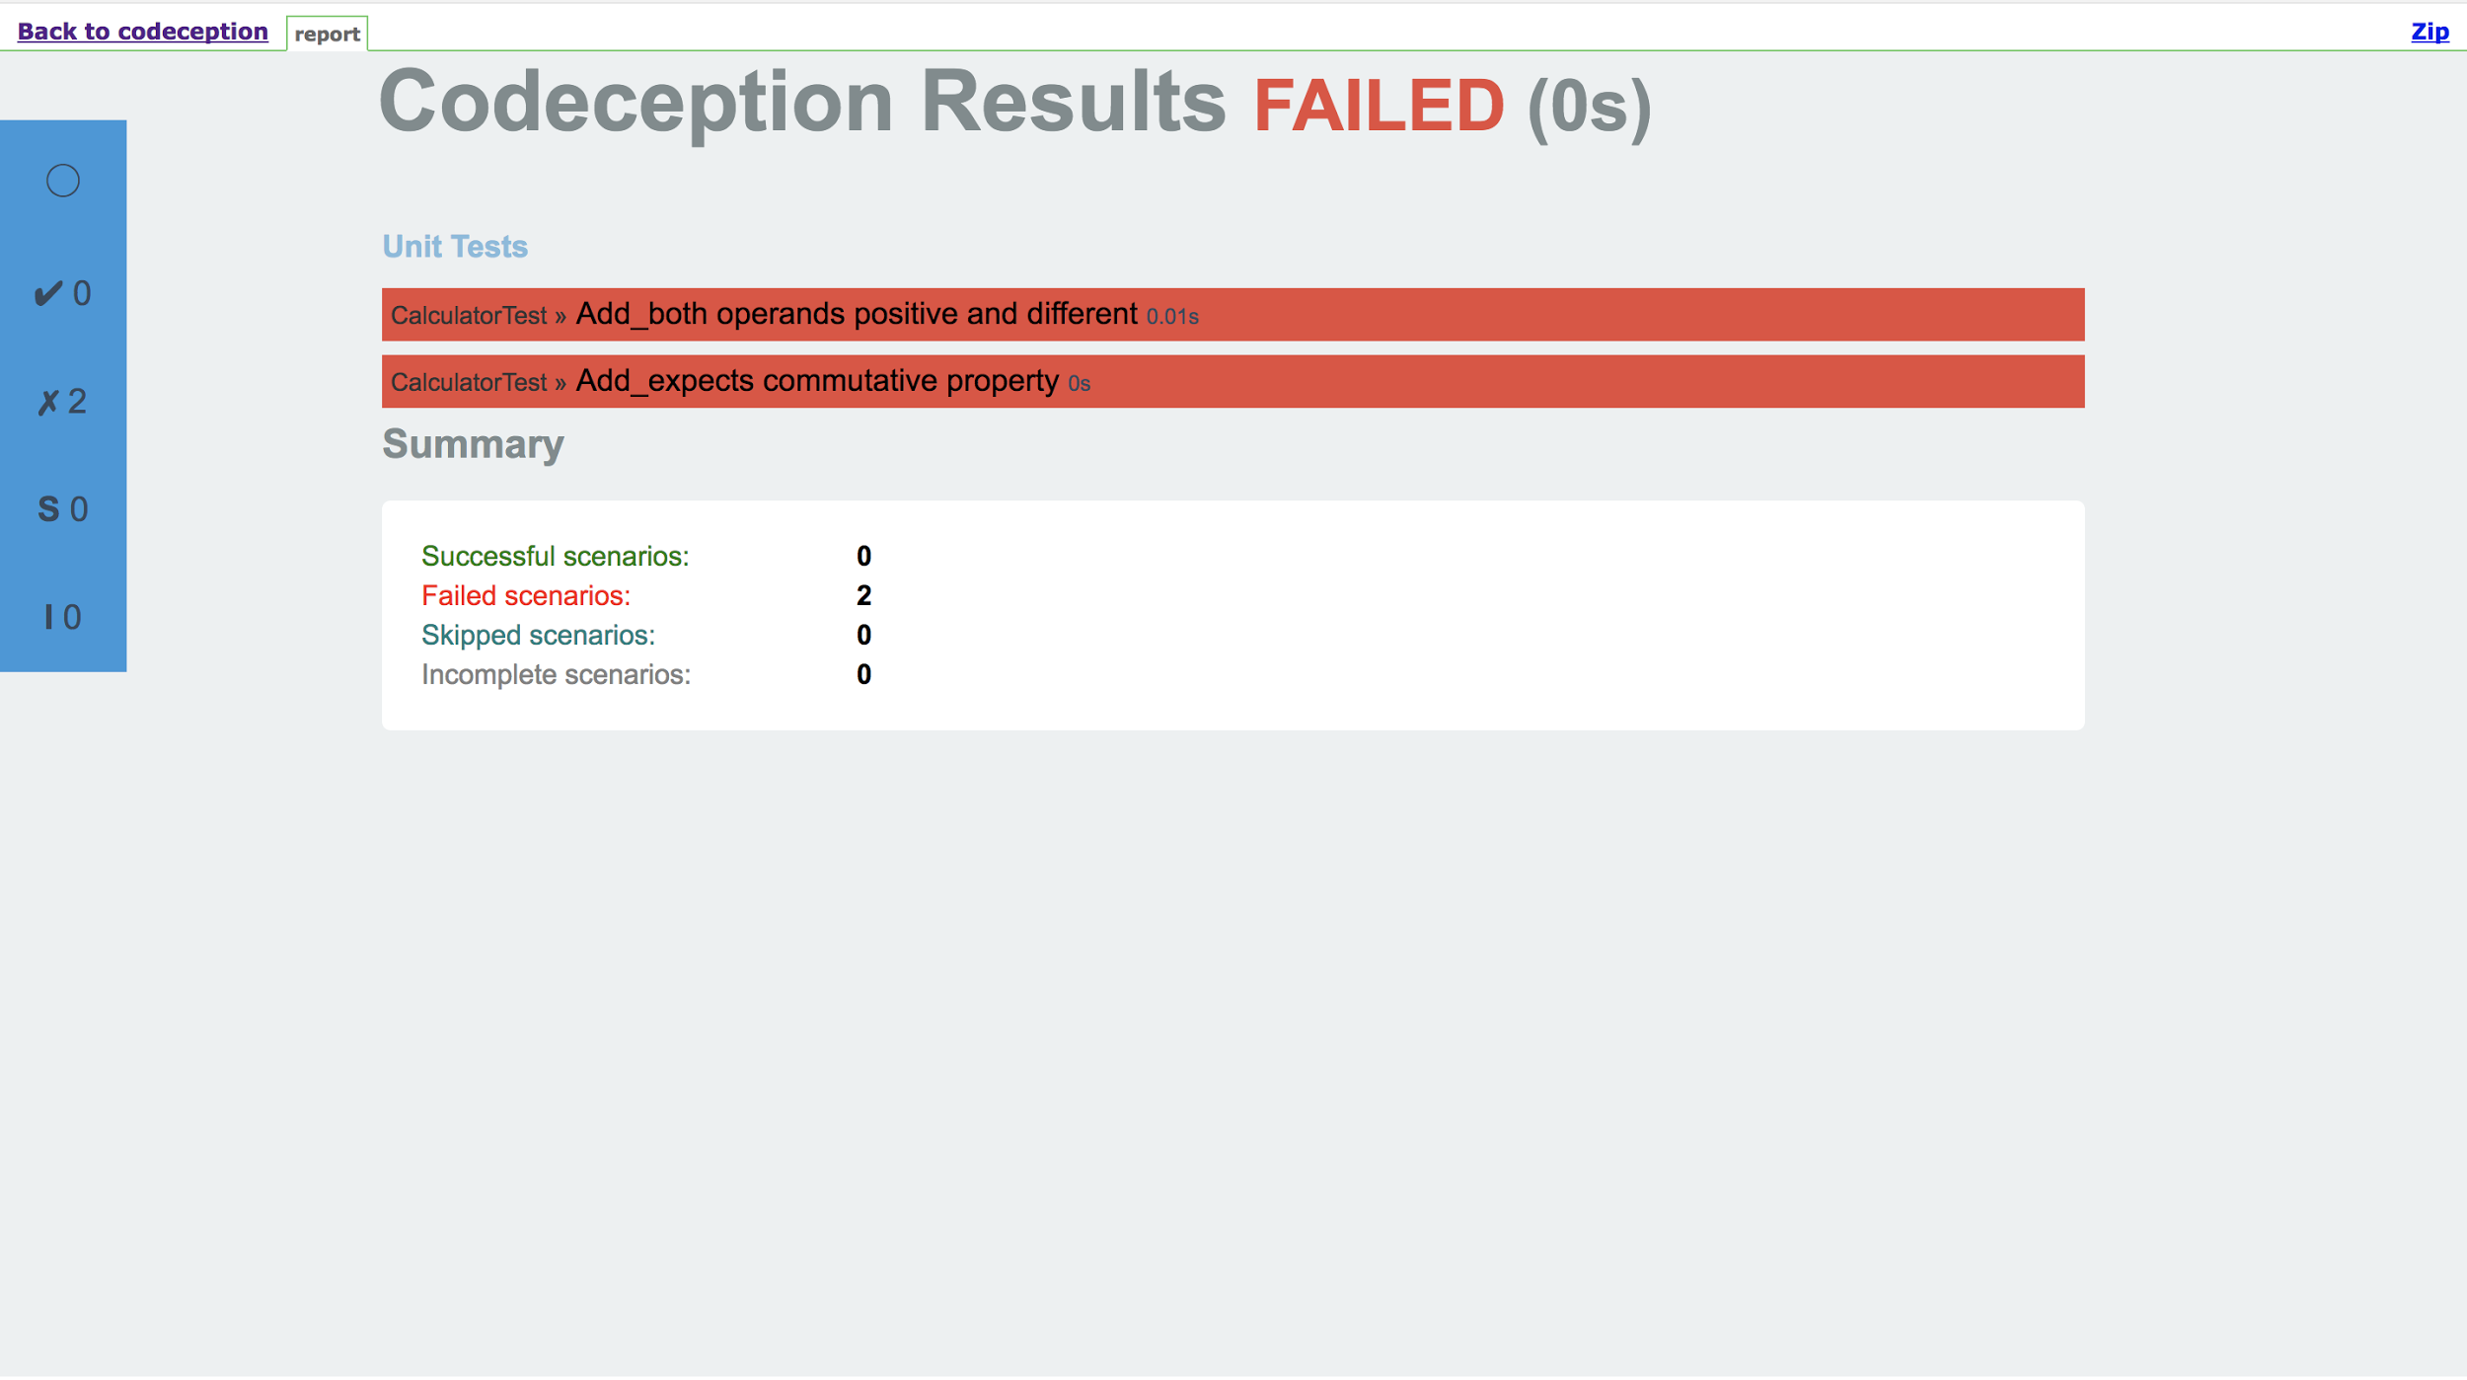

Slide 37
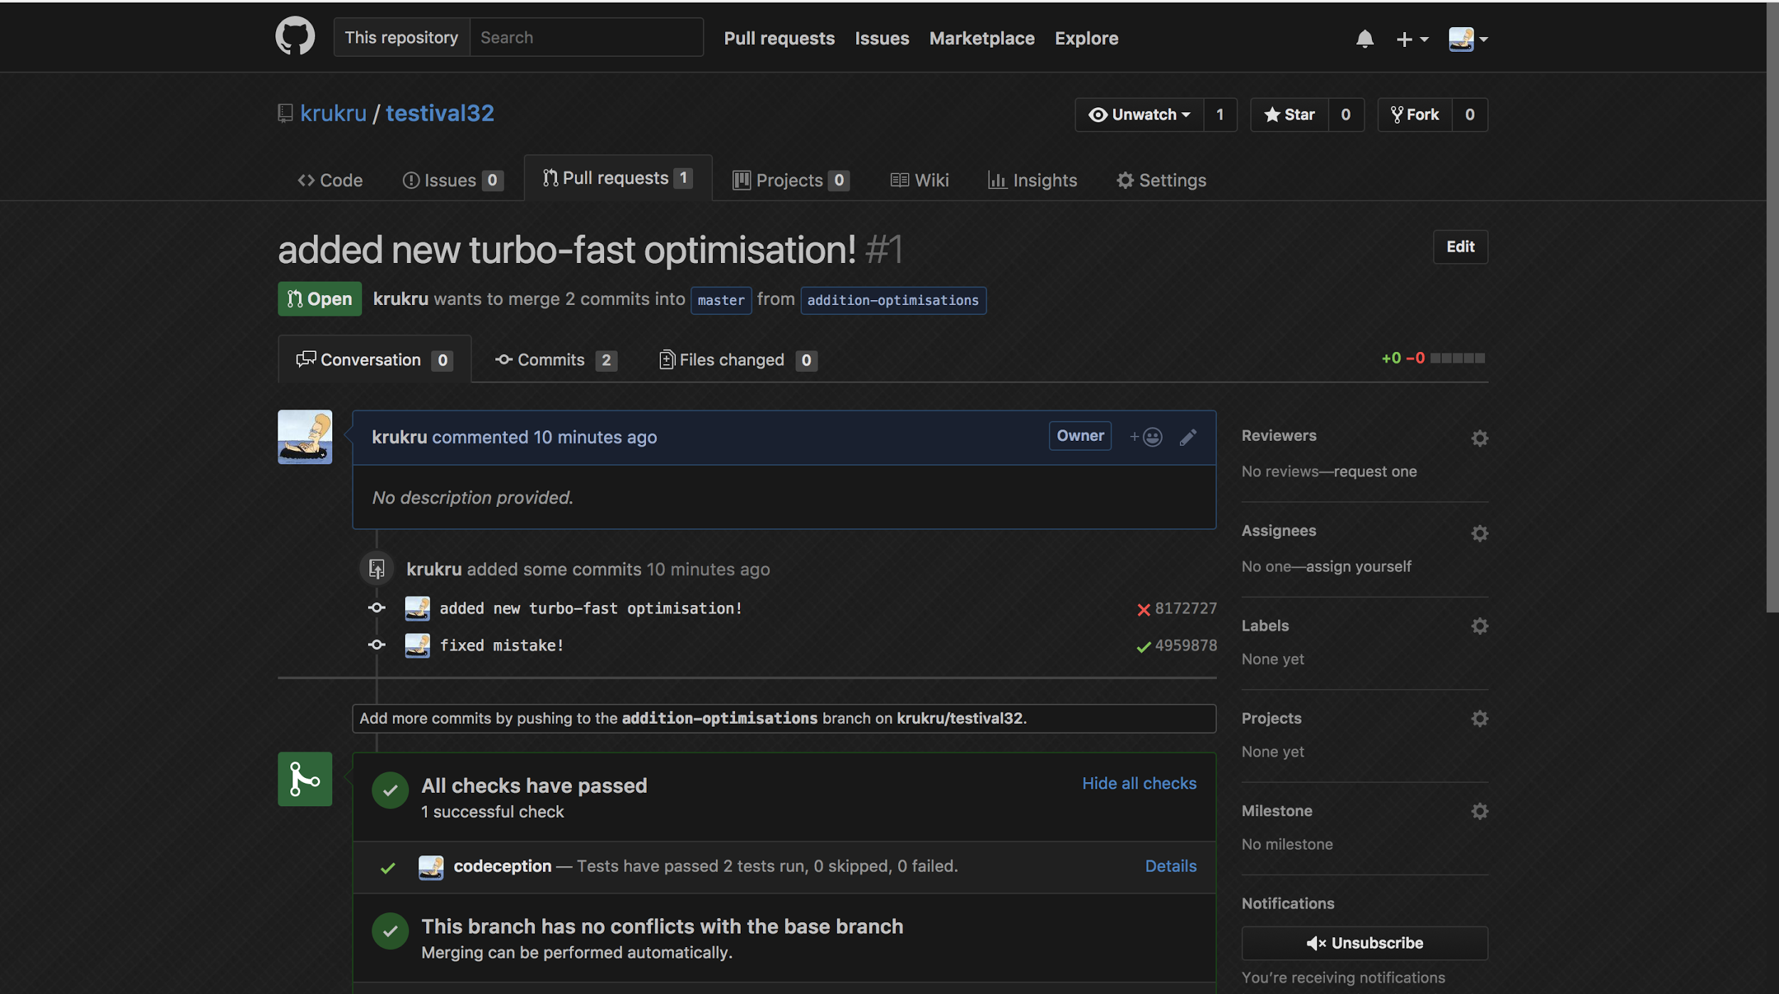

Slide 38
Thank you for coming to Testival #32
Please feel free to ask any questions
Follow me on github @krukru

